Slide 1
Mirror Matches
24 Annotations + 38 Analogs

Slide 2
Annotations

Slide 3
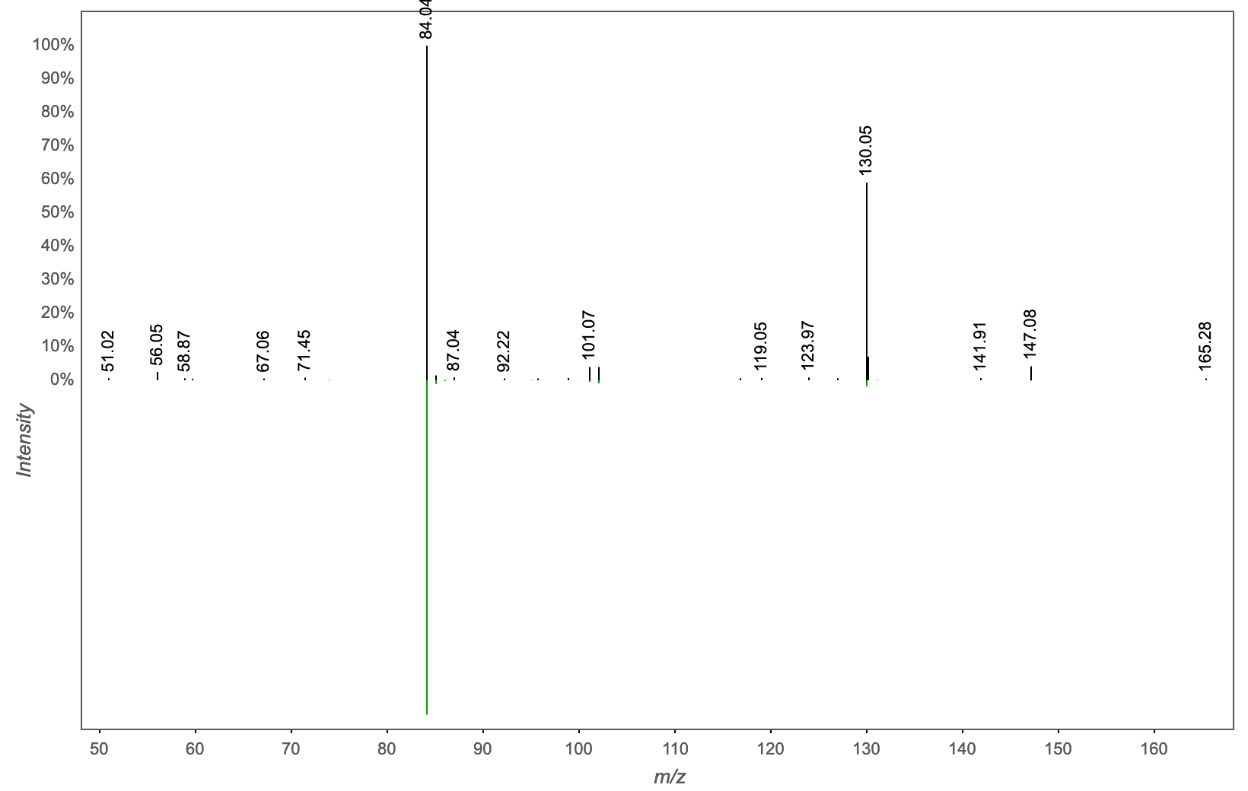
Annotation | M/Z | RT | Cosine Score | Shared Peaks | Cluster Index
Massbank:RP001302 L-Glutamine|(2S)-5-amino-2-azaniumyl-5-oxopentanoate | 147.076 | 0.33 | 0.8617 | 4 | 958

Slide 4
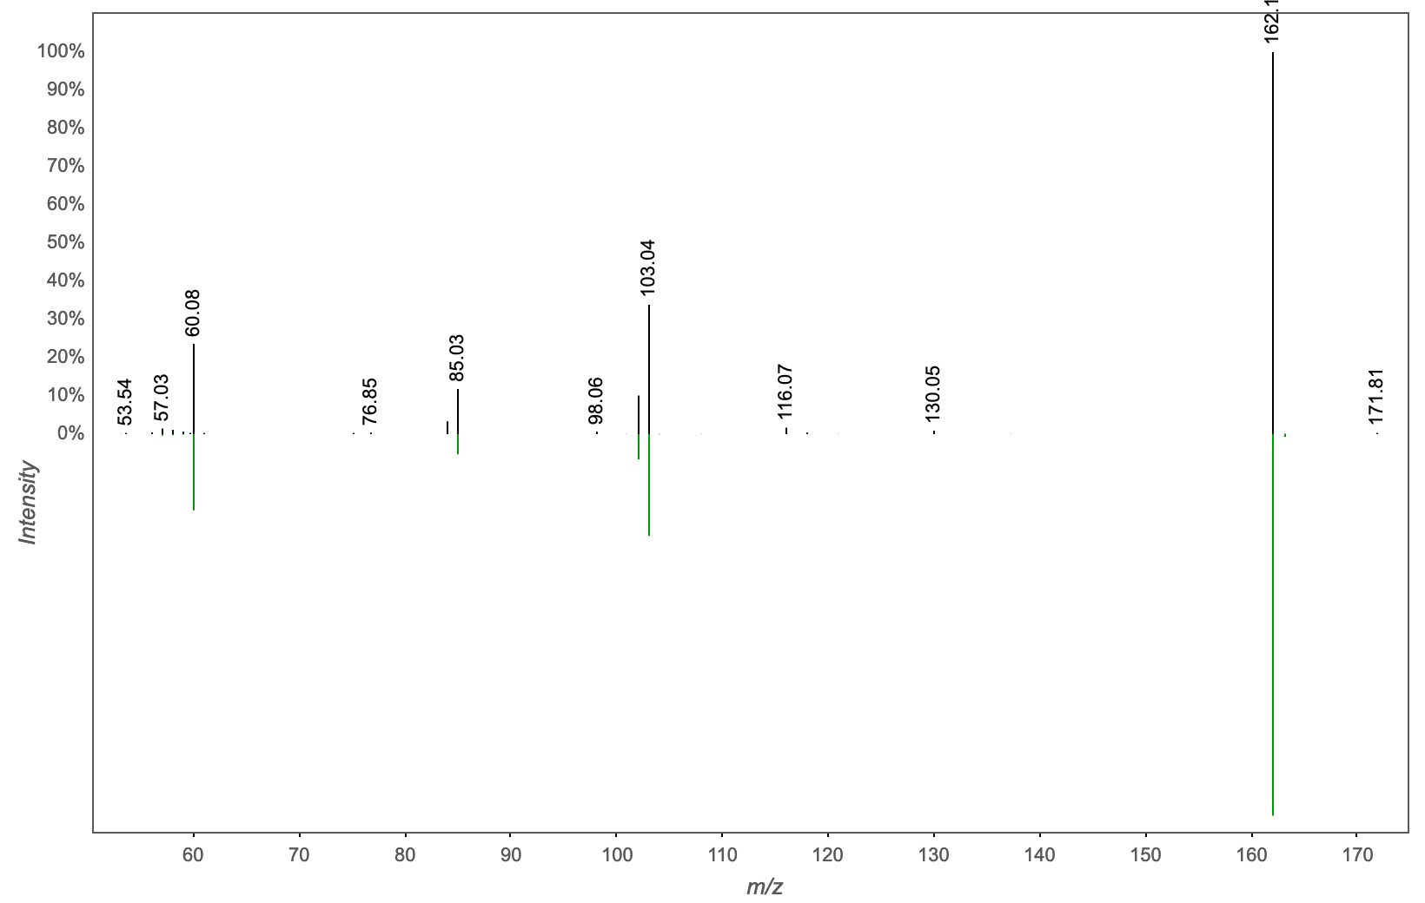
Annotation | M/Z | RT | Cosine Score | Shared Peaks | Cluster Index
L-CARNITINE | 162.112 | 0.25 | 0.9624 | 5 | 971

Slide 5
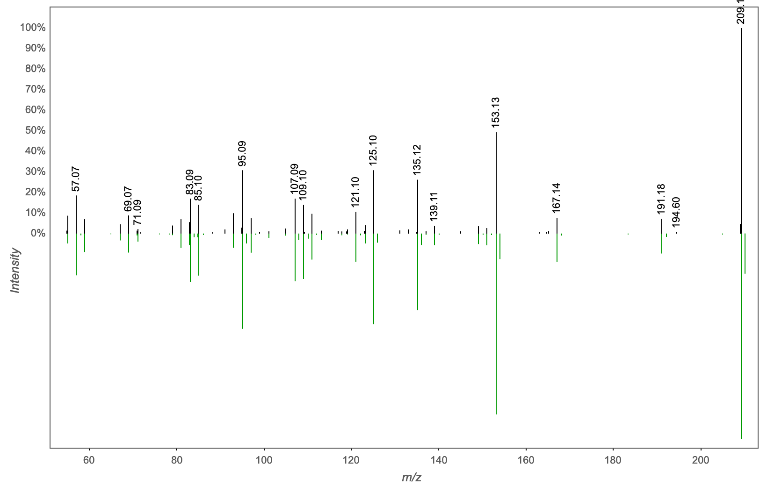
Annotation | M/Z | RT | Cosine Score | Shared Peaks | Cluster Index
Spectral Match to 2,4,7,9-Tetramethyl-5-decyne-4,7-diol from NIST14 | 209.189 | 2.83 | 0.9520 | 9 | 1307

Slide 6
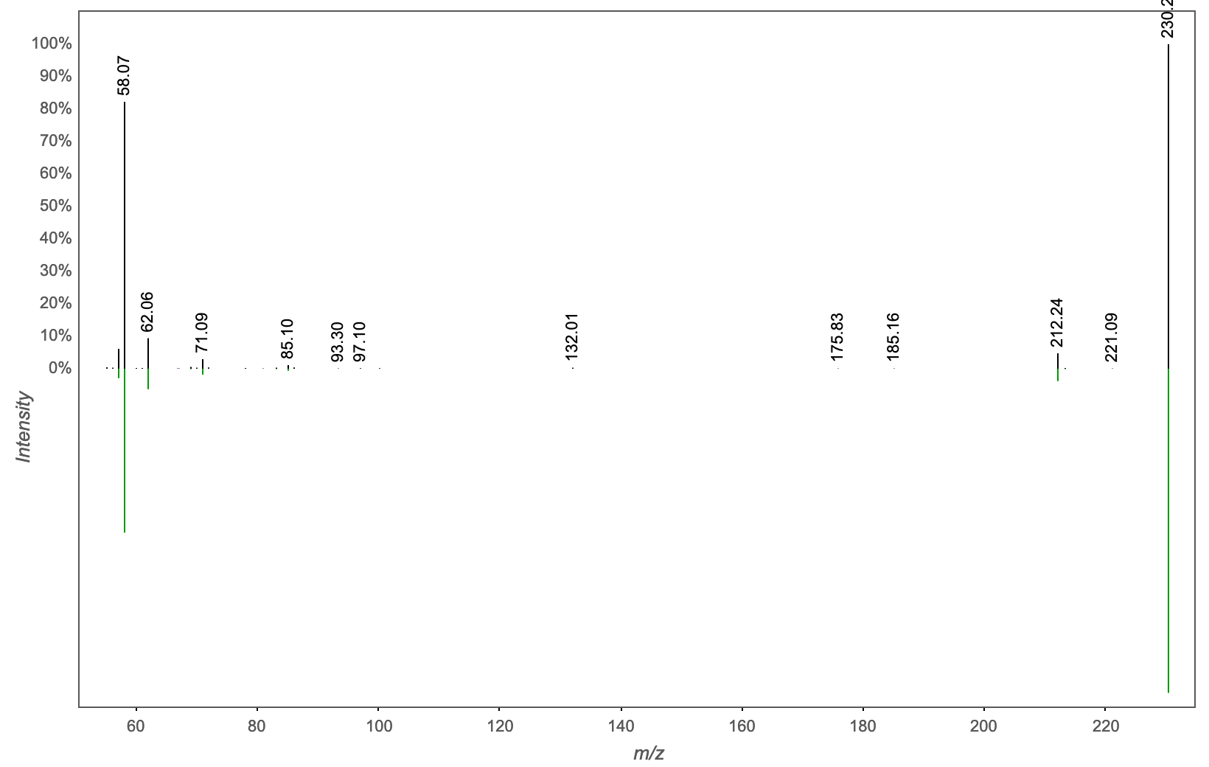
Annotation | M/Z | RT | Cosine Score | Shared Peaks | Cluster Index
MassbankEU:SM876801 N,N-Dimethyldodecylamine N-oxide|Lauramine oxide|N,N-dimethyldodecan-1-amine oxide | 230.247 | 2.72 | 0.9671 | 6 | 1024

Slide 7
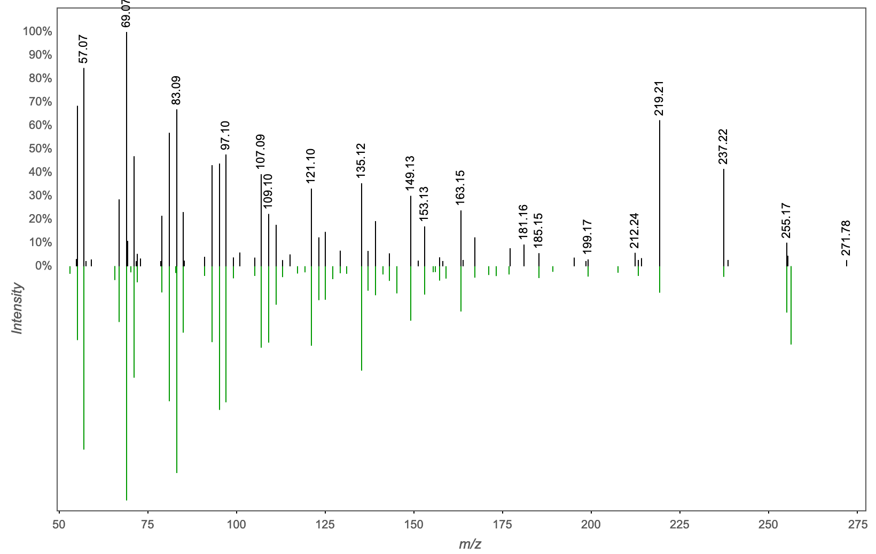
Annotation | M/Z | RT | Cosine Score | Shared Peaks | Cluster Index
Spectral Match to Palmitelaidic acid from NIST14 | 255.231 | 2.93 | 0.8066 | 9 | 2176

Slide 8
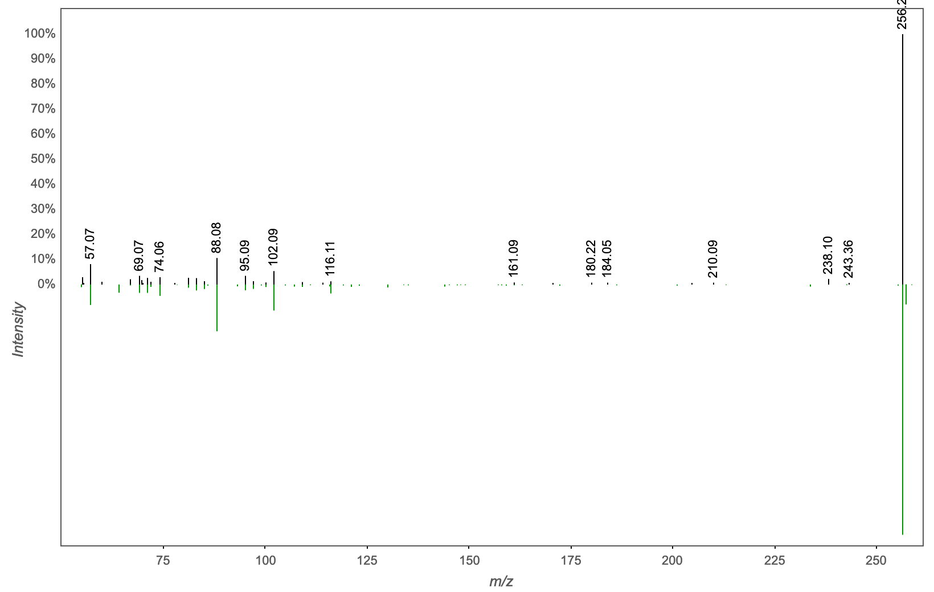
Annotation | M/Z | RT | Cosine Score | Shared Peaks | Cluster Index
Spectral Match to Palmitamide from NIST14 | 256.262 | 3.17 | 0.8300 | 6 | 1113

Slide 9
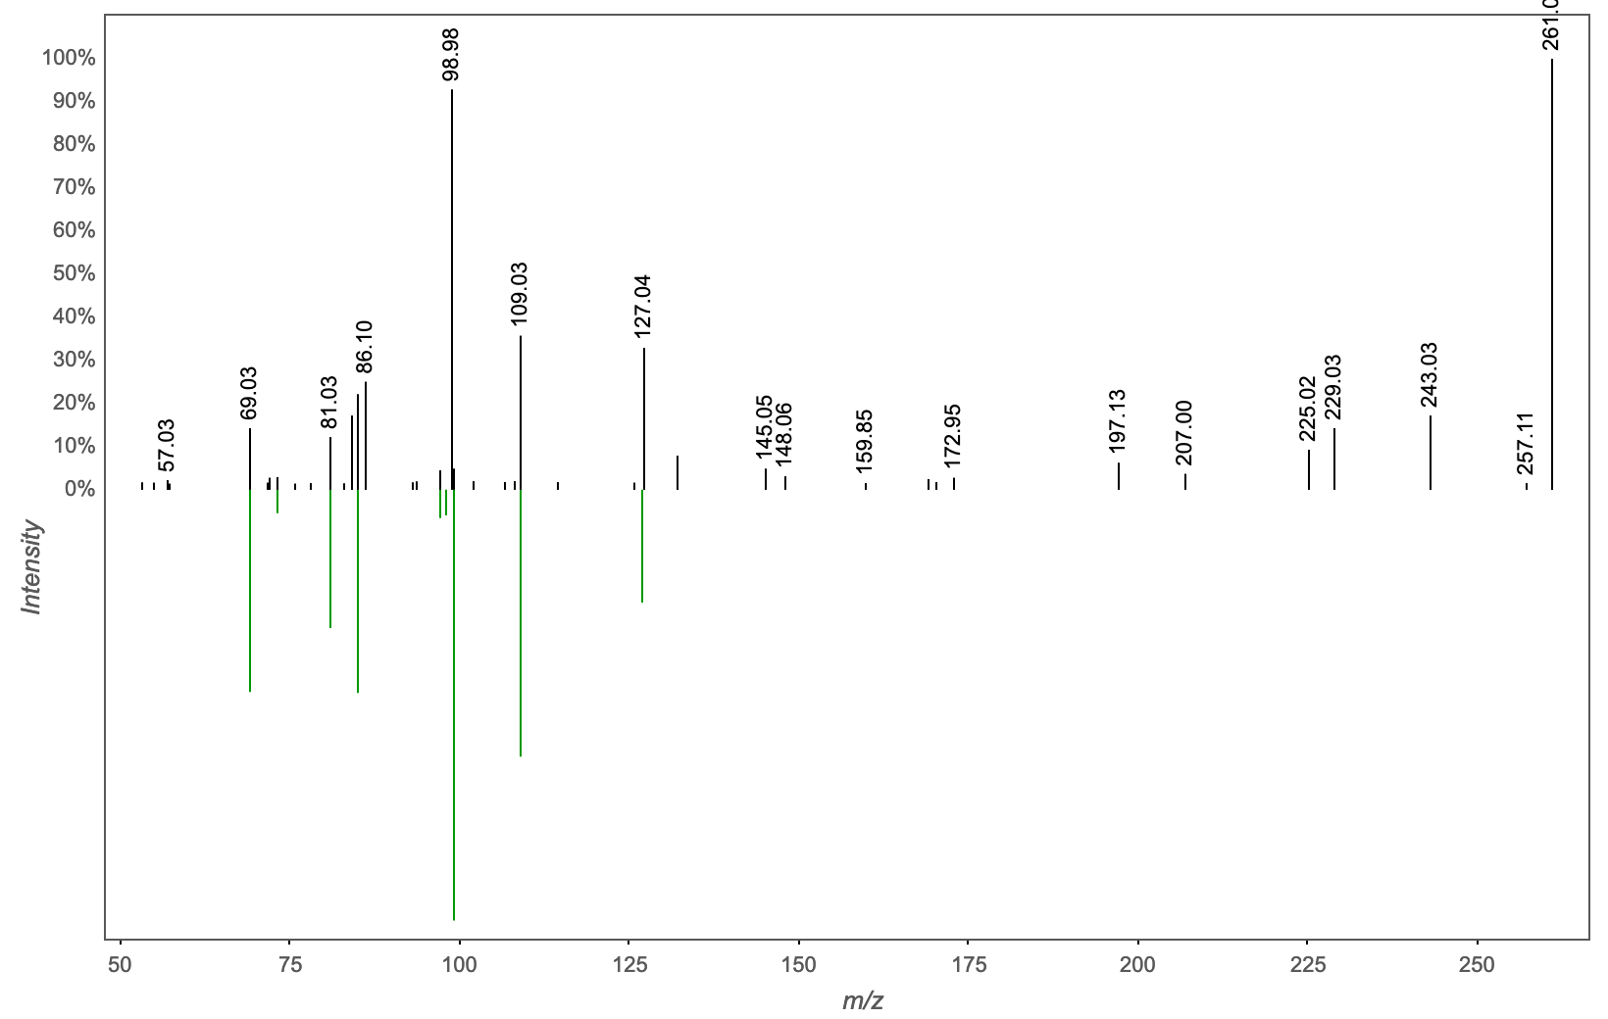
Annotation | M/Z | RT | Cosine Score | Shared Peaks | Cluster Index
HMDB:HMDB01078-1419 Mannose 6-phosphate | 261.057 | 0.32 | 0.7808 | 5 | 1436

Slide 10
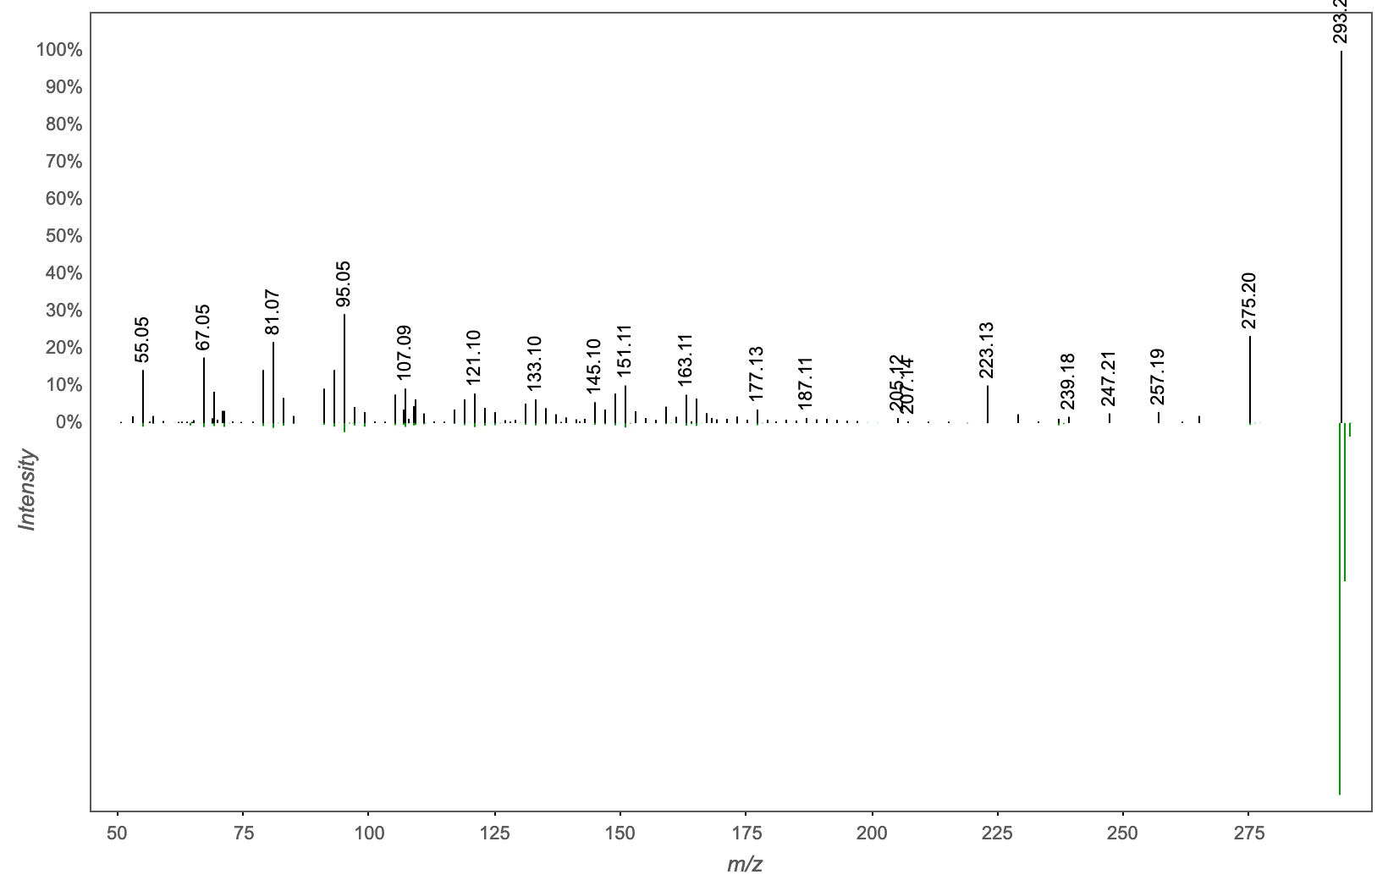
Annotation | M/Z | RT | Cosine Score | Shared Peaks | Cluster Index
Spectral Match to trans-EKODE-(E)-Ib from NIST14 | 293.21 | 2.54 | 0.7150 | 9 | 2272

Slide 11
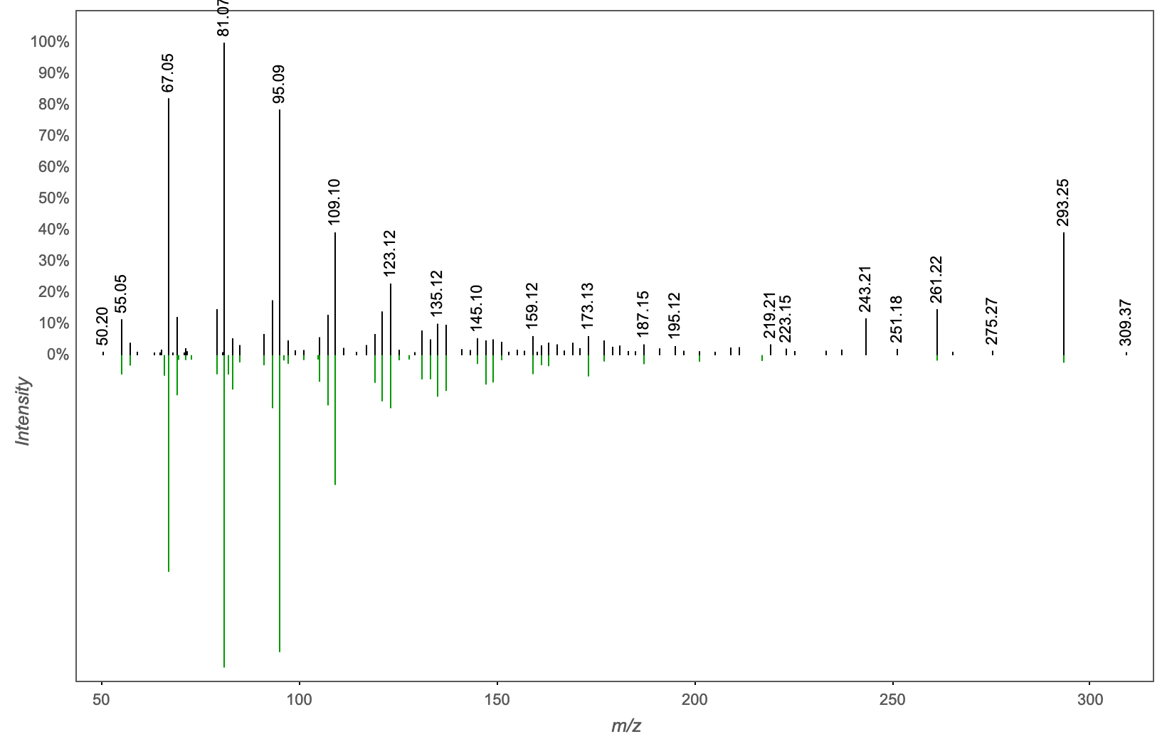
Annotation | M/Z | RT | Cosine Score | Shared Peaks | Cluster Index
Spectral Match to 9Z,11E,13E-Octadecatrienoic acid methyl ester from NIST14 | 293.246 | 3.29 | 0.9413 | 7 | 2117

Slide 12
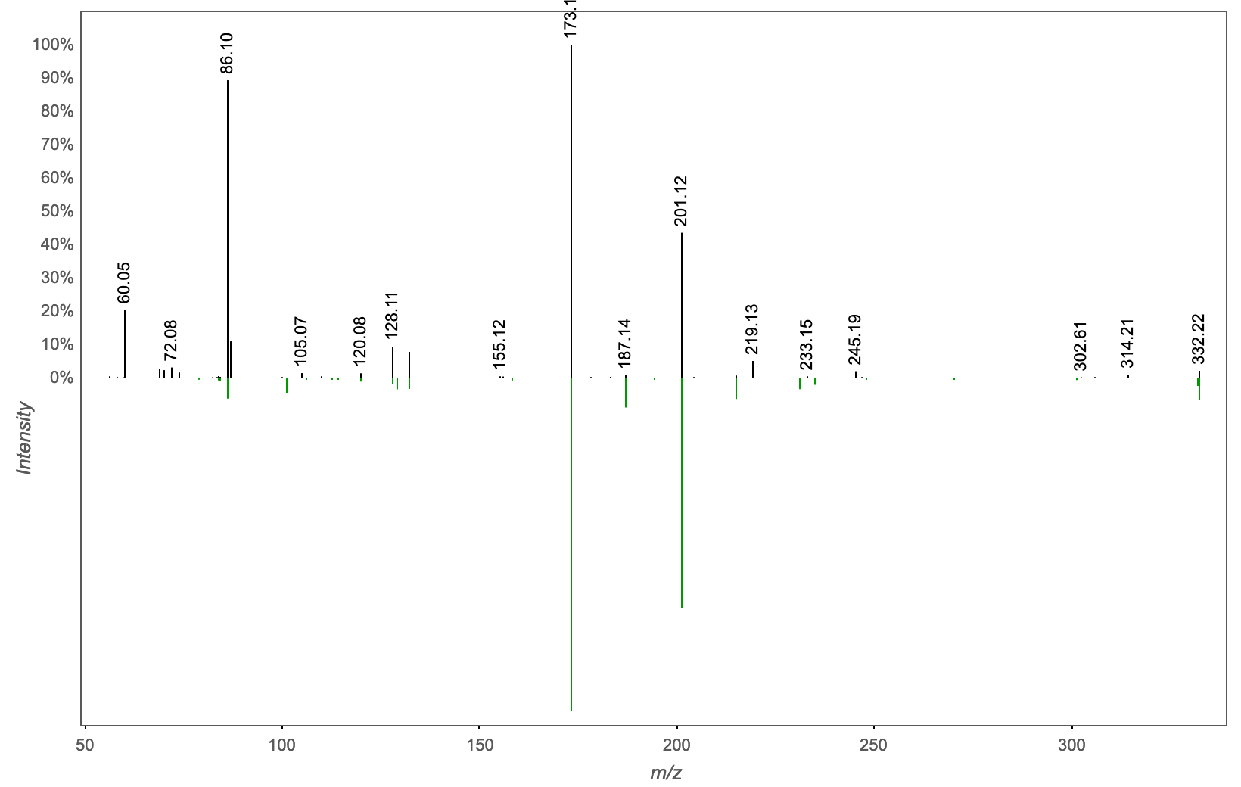
Annotation | M/Z | RT | Cosine Score | Shared Peaks | Cluster Index
Spectral Match to Thr-Val-Leu from NIST14 | 332.218 | 2.21 | 0.7642 | 7 | 4319

Slide 13
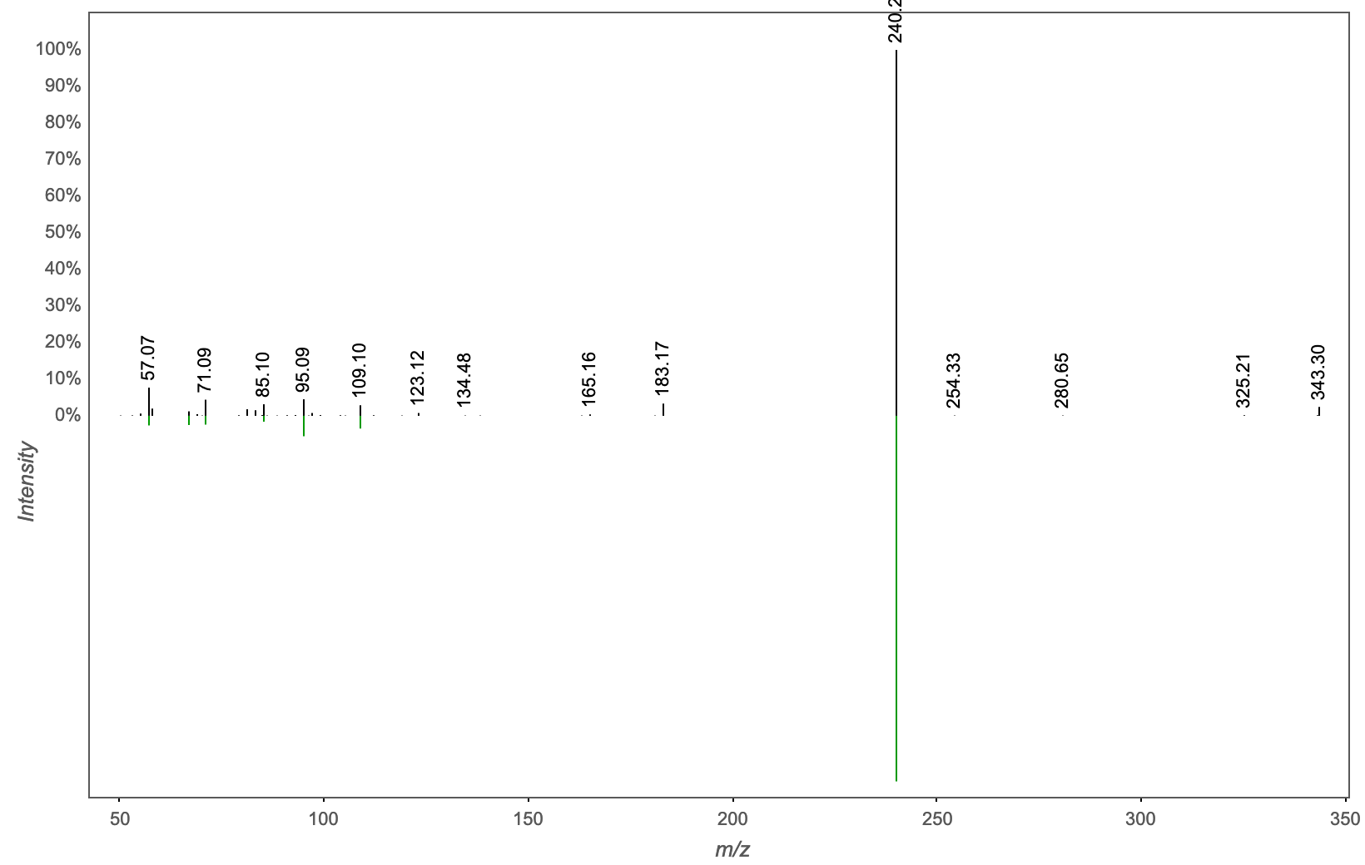
Annotation | M/Z | RT | Cosine Score | Shared Peaks | Cluster Index
Massbank: Lauramidopropyl betaine|3-(Dodecanoylamino)propyl(carboxymethyl)dimethylammonium|carboxymethyl-[3-(dodecanoylamino)propyl]-dimethylazanium | 343.294 | 2.66 | 0.9572 | 6 | 955

Slide 14
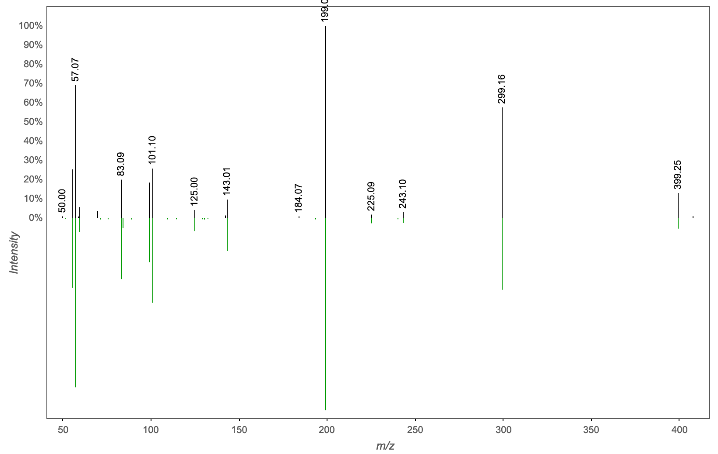
Annotation | M/Z | RT | Cosine Score | Shared Peaks | Cluster Index
Spectral Match to Tris(2-butoxyethyl) phosphate from NIST14 | 399.249 | 3.02 | 0.9846 | 12 | 1769

Slide 15
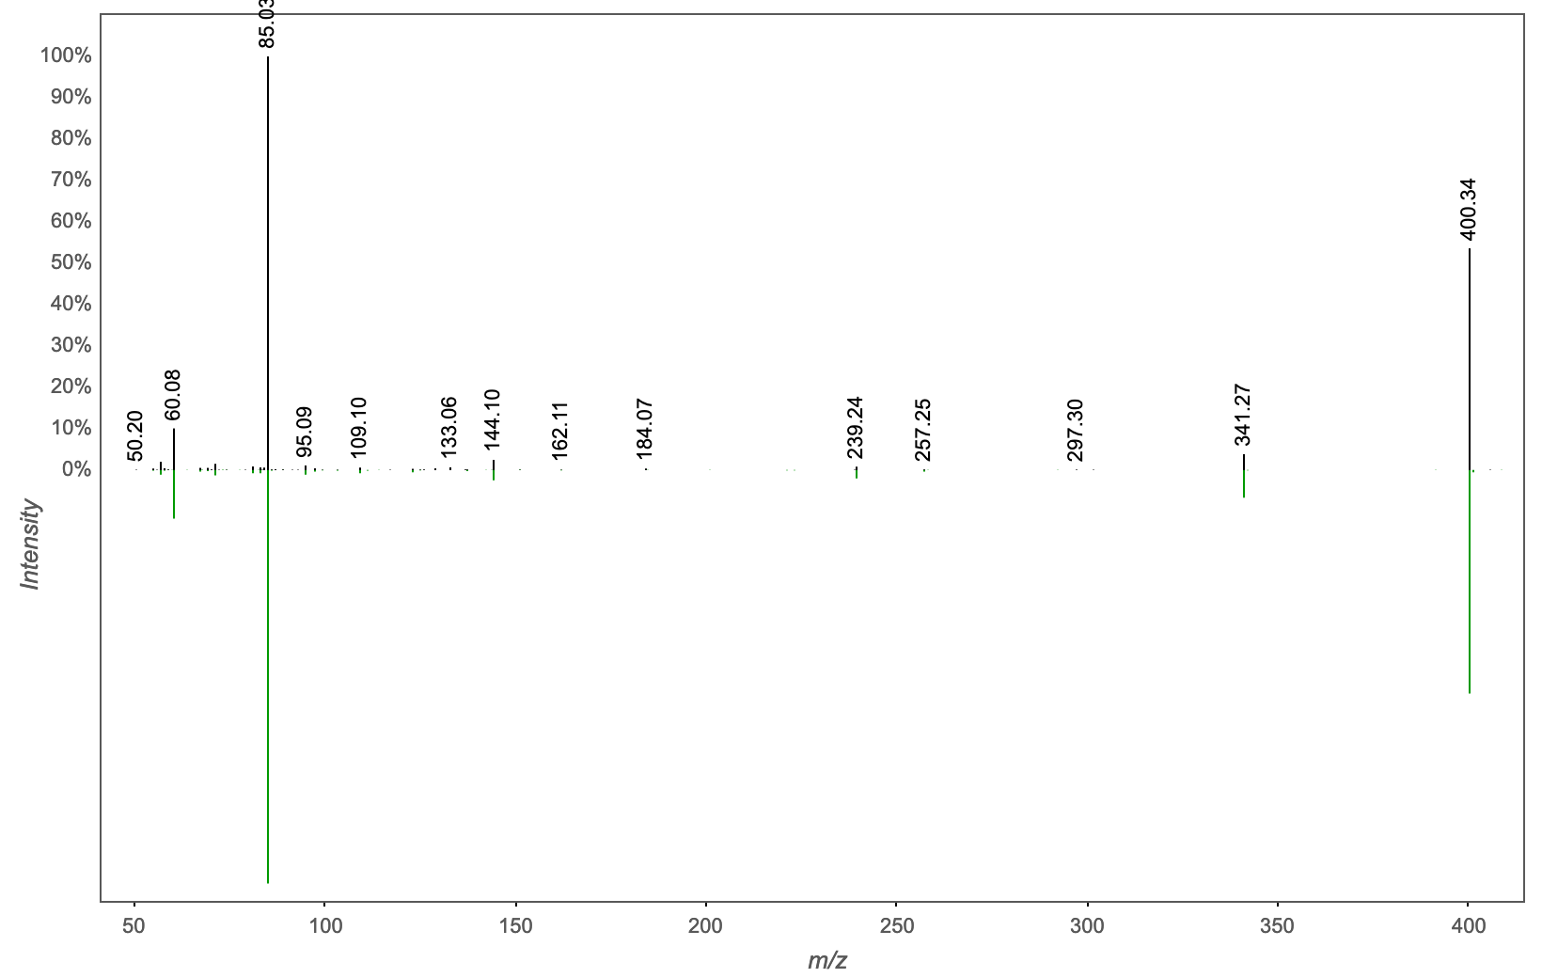
Annotation | M/Z | RT | Cosine Score | Shared Peaks | Cluster Index
PALMITOYLCARNITINE | 400.34 | 2.9 | 0.9715 | 8 | 989

Slide 16
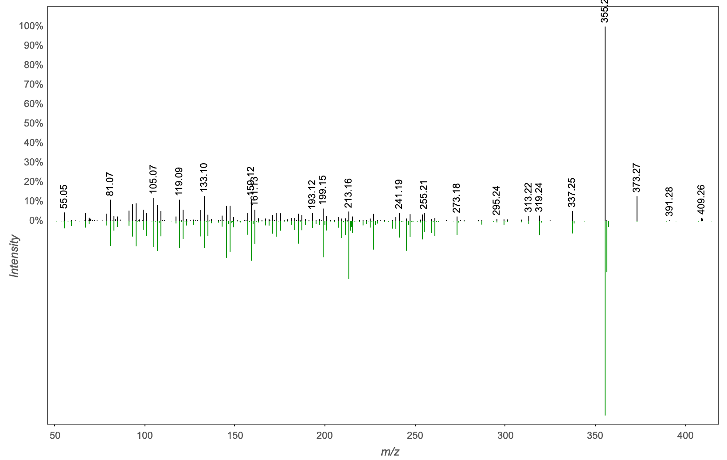
Annotation | M/Z | RT | Cosine Score | Shared Peaks | Cluster Index
CHOLIC ACID | 409.293 | 2.7 | 0.8133 | 17 | 4789

Slide 17
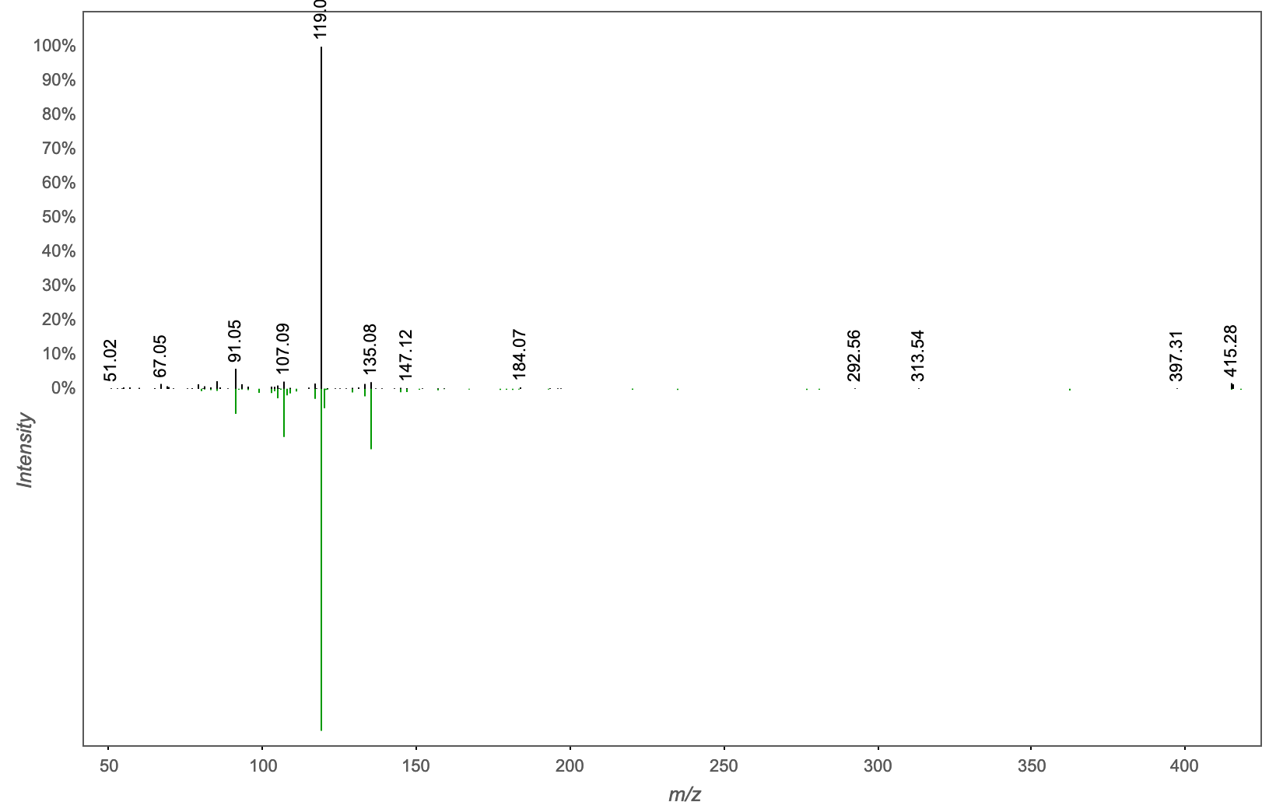
Annotation | M/Z | RT | Cosine Score | Shared Peaks | Cluster Index
NCGC00385811-01!6-[3-[(3,4-dimethoxyphenyl)methyl]-4-methoxy-2-(methoxymethyl)butyl]-4-methoxy-1,3-benzodioxole | 415.21 | 2.81 | 0.9054 | 5 | 949

Slide 18
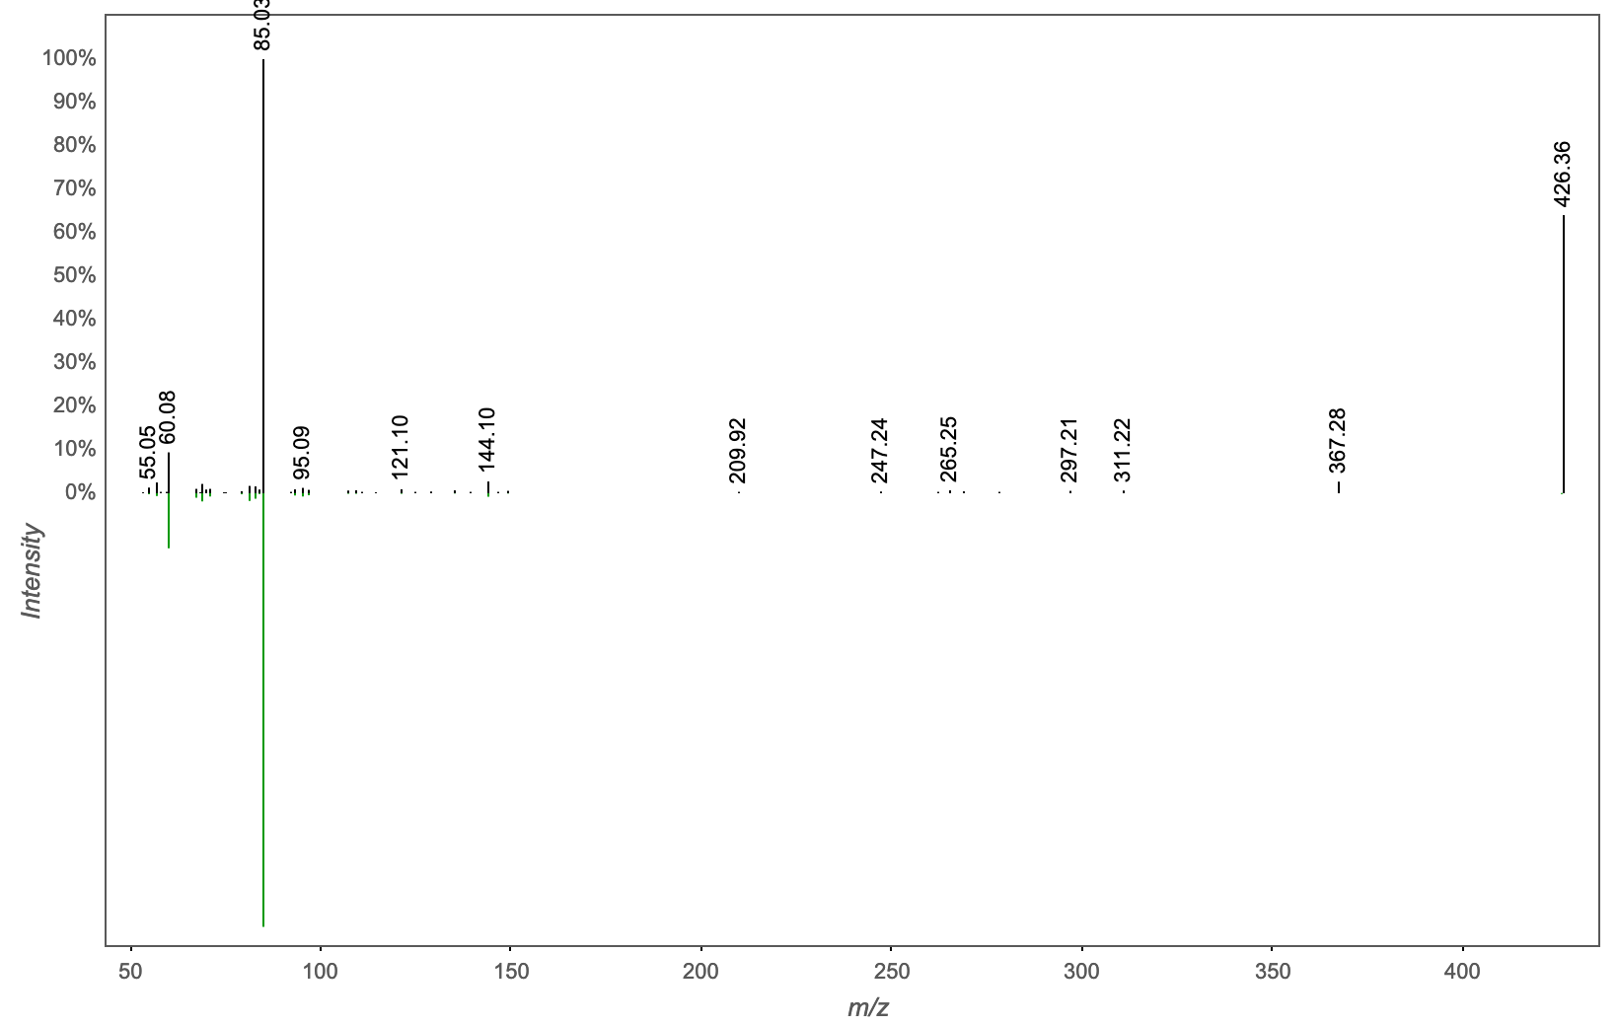
Annotation | M/Z | RT | Cosine Score | Shared Peaks | Cluster Index
Massbank:RP025103 Oleoyl-L-Carnitine|(3R)-3-[(Z)-octadec-9-enoyl]oxy-4-(trimethylazaniumyl)butanoate | 426.356 | 2.92 | 0.9560 | 7 | 1568

Slide 19
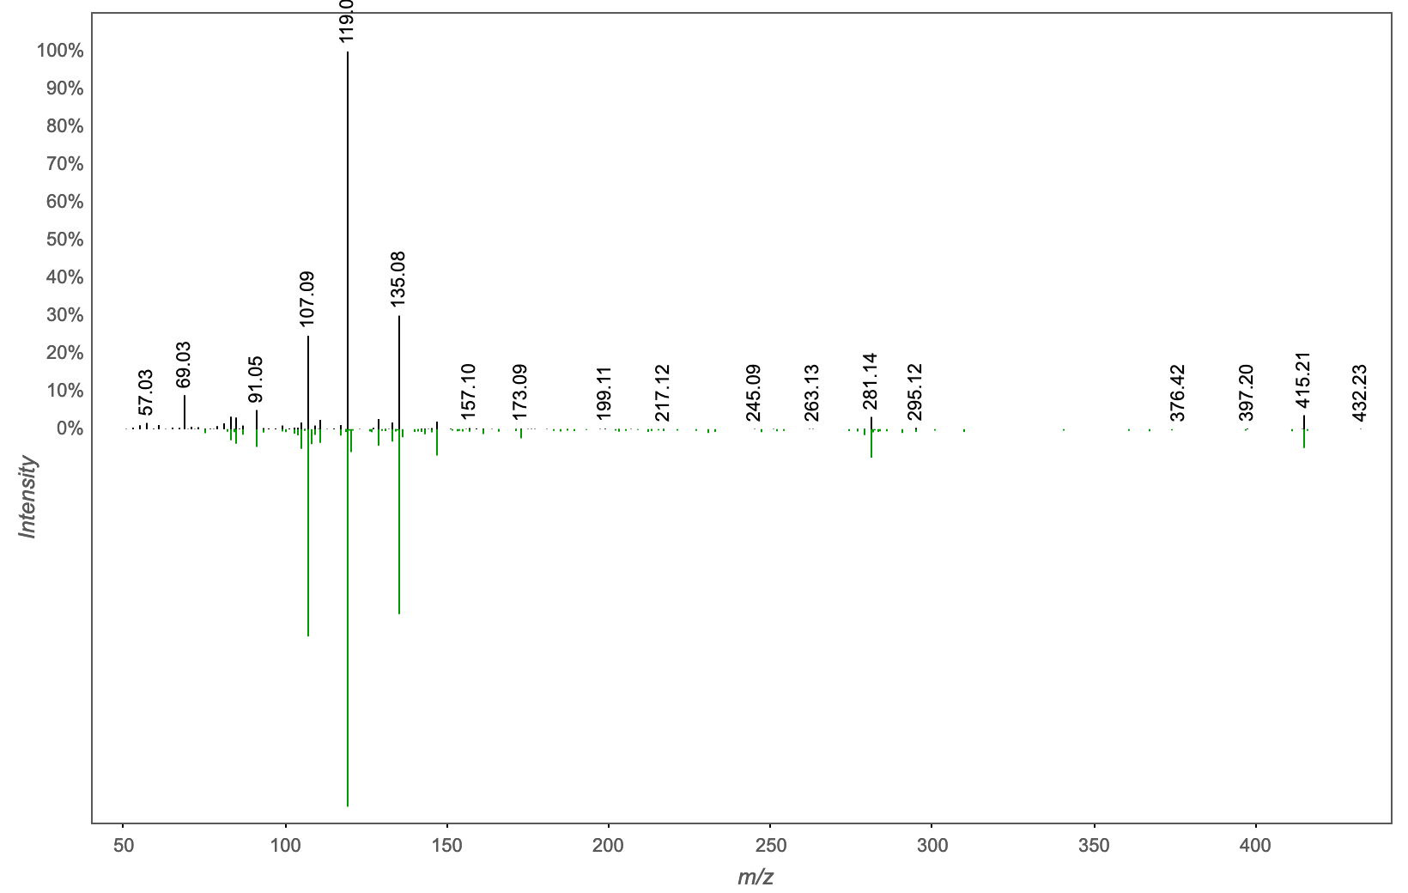
Annotation | M/Z | RT | Cosine Score | Shared Peaks | Cluster Index
NCGC00385123-01_C22H30O6_7b,9-Dihydroxy-3-(hydroxymethyl)-1,1,6,8-tetramethyl-5-oxo-1,1a,1b,4,4a,5,7a,7b,8,9-decahydro-9aH-cyclopropa[3,4]benzo[1,2-e]azulen-9a-yl acetate | 432.236 | 2.81 | 0.8828 | 8 | 965

Slide 20
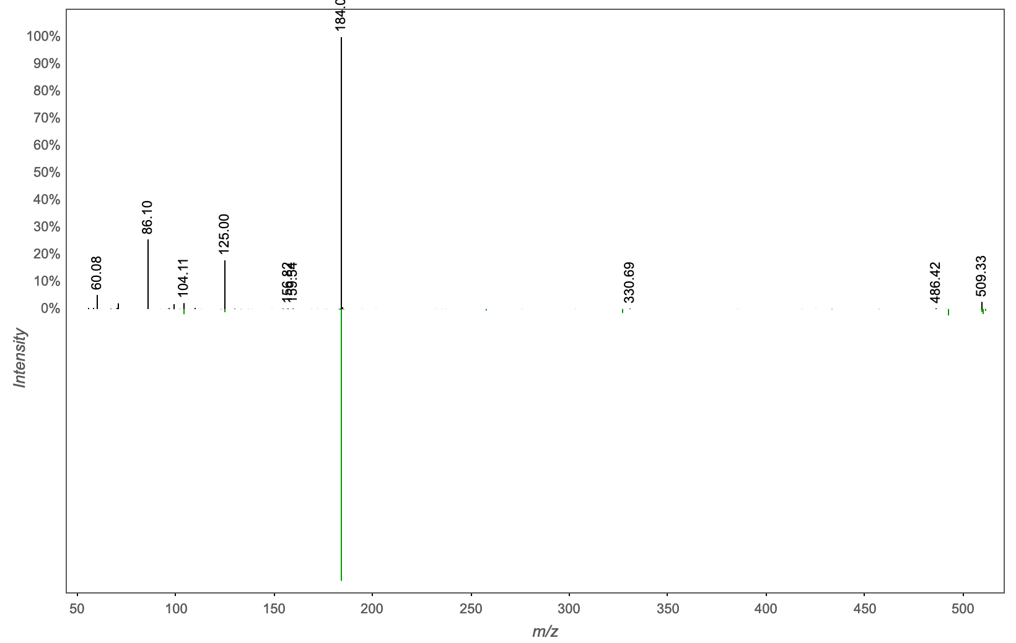
Annotation | M/Z | RT | Cosine Score | Shared Peaks | Cluster Index
PC(17:0/0:0); [M+H]+ C25H53N1O7P1 | 509.334 | 2.83 | 0.8127 | 4 | 1244

Slide 21
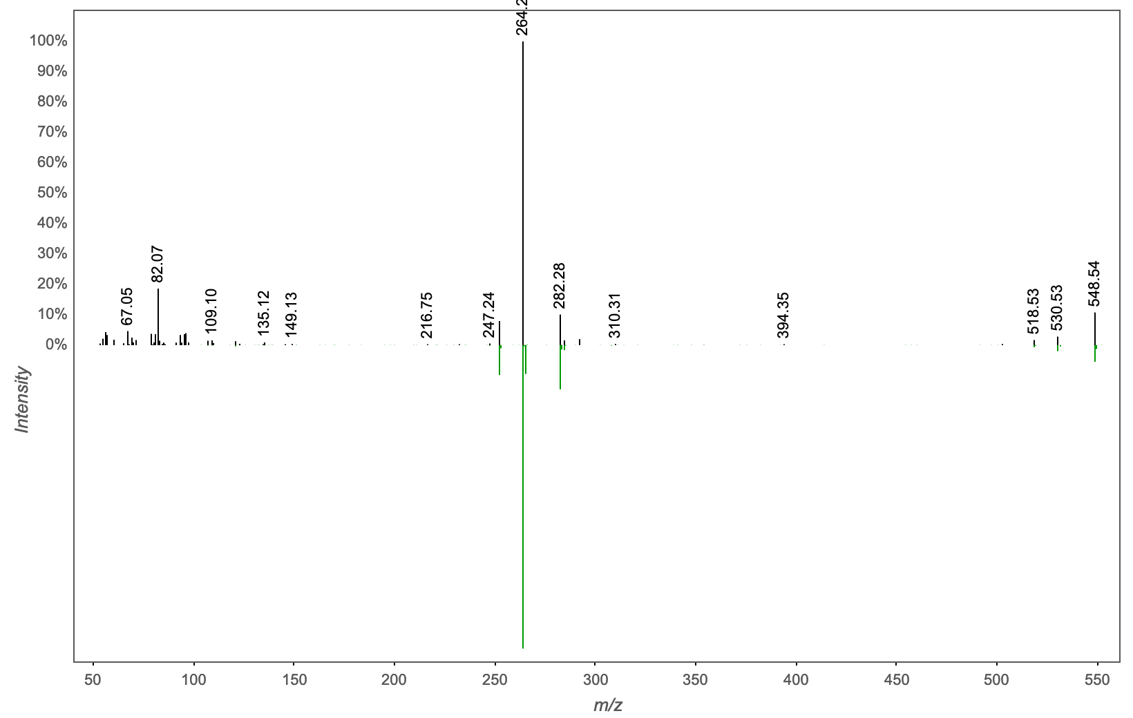
Annotation | M/Z | RT | Cosine Score | Shared Peaks | Cluster Index
N-[1,3-dihydroxyoctadec-4-en-2-yl]octadecanamide | 548.538 | 4.3 | 0.8074 | 7 | 2926

Slide 22
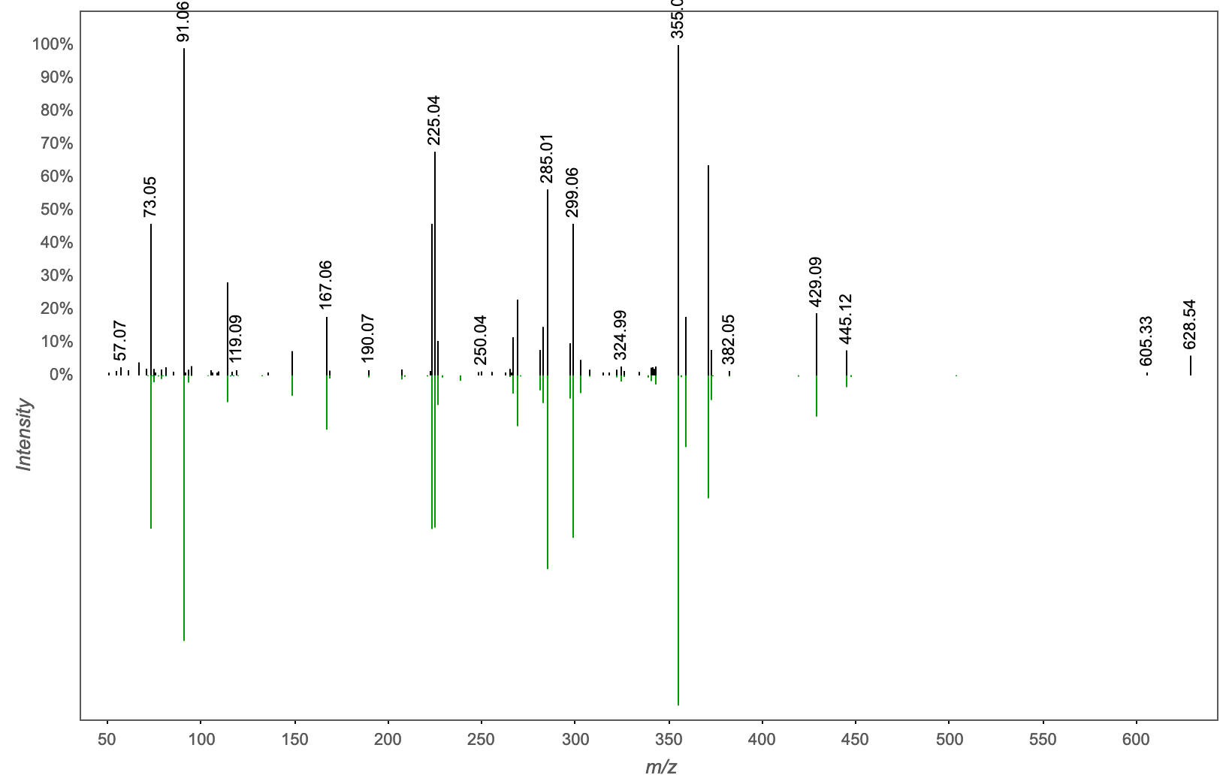
Annotation | M/Z | RT | Cosine Score | Shared Peaks | Cluster Index
Contaminant vial septum ThermoFisher C5000-44B | 628.192 | 3.63 | 0.9685 | 21 | 1687

Slide 23
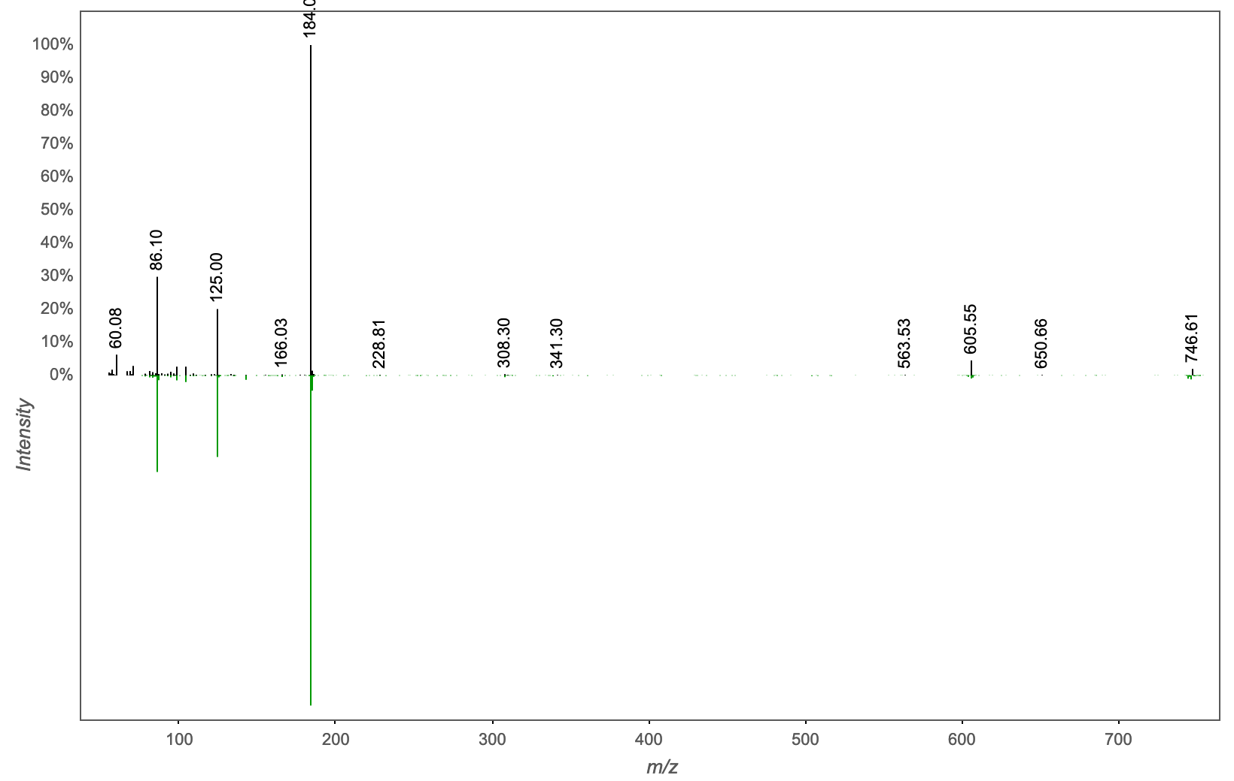
Annotation | M/Z | RT | Cosine Score | Shared Peaks | Cluster Index
Spectral Match to 1-Hexadecyl-2-(9Z-octadecenoyl)-sn-glycero-3-phosphocholine from NIST14 | 746.603 | 3.31 | 0.9203 | 9 | 982

Slide 24
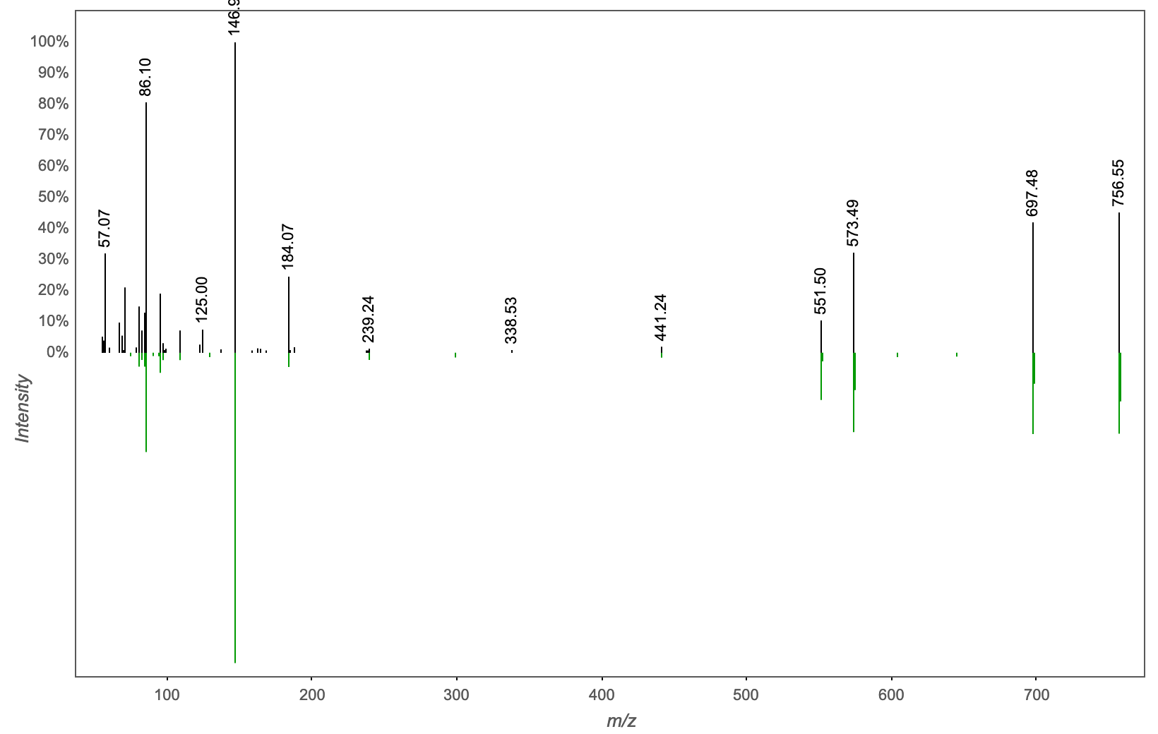
Annotation | M/Z | RT | Cosine Score | Shared Peaks | Cluster Index
Spectral Match to 1,2-Dihexadecanoyl-sn-glycero-3-phosphocholine from NIST14 | 756.548 | 3.24 | 0.8277 | 11 | 2107

Slide 25
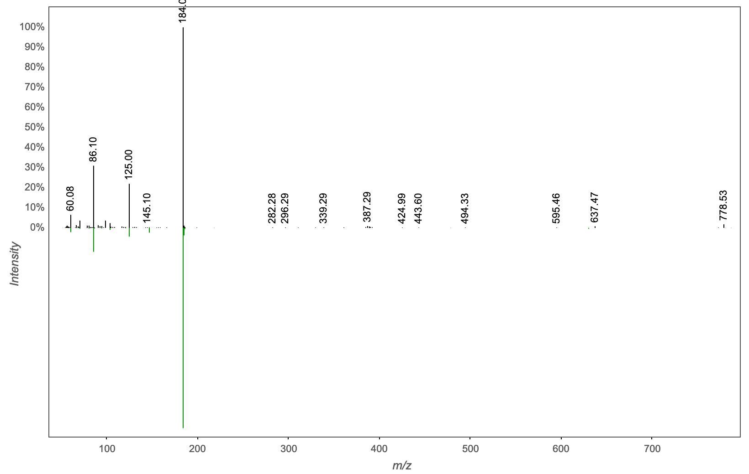
Annotation | M/Z | RT | Cosine Score | Shared Peaks | Cluster Index
Spectral Match to 1,2-Di-(9Z,12Z,15Z-octadecatrienoyl)-sn-glycero-3-phosphocholine from NIST14 | 778.534 | 3.59 | 0.9224 | 10 | 2375

Slide 26
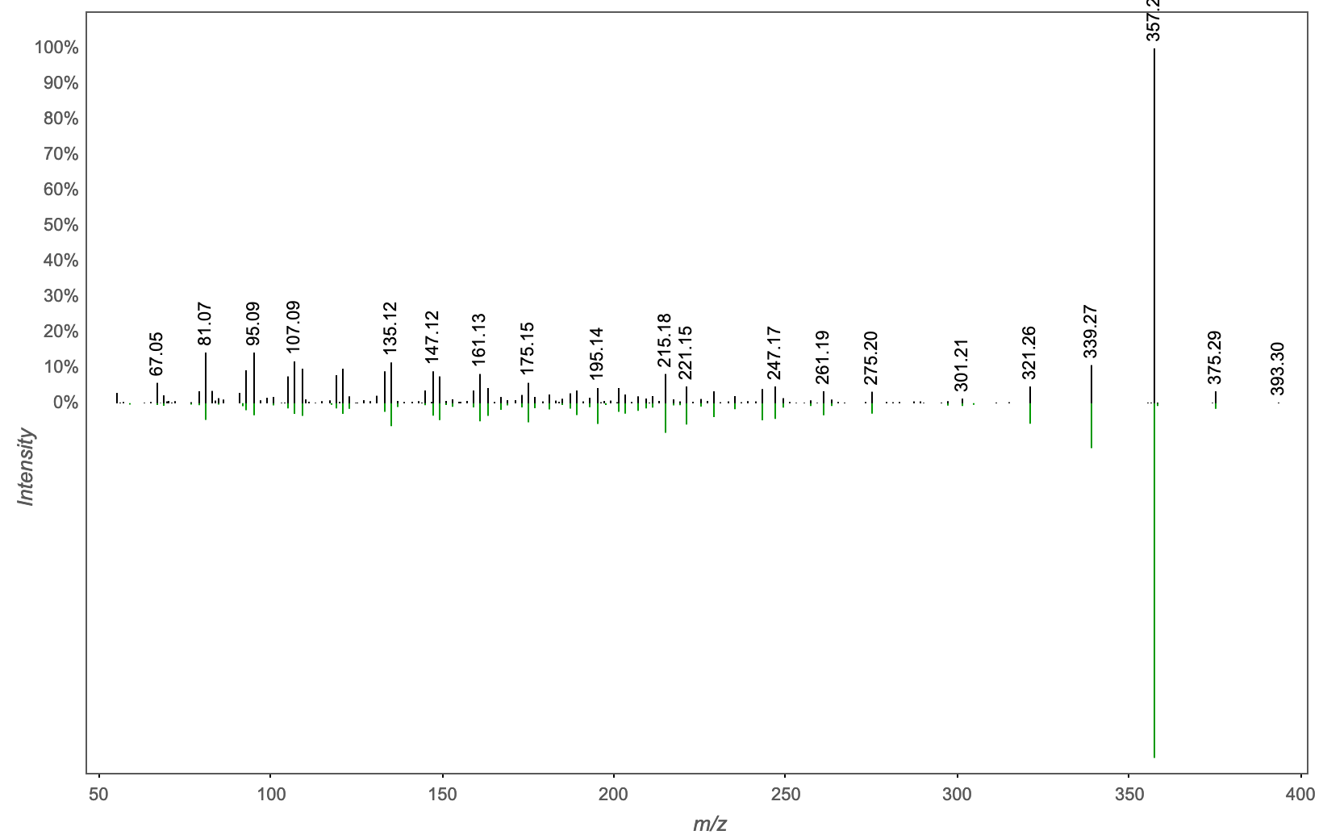
Annotation | M/Z | RT | Cosine Score | Shared Peaks | Cluster Index
deoxycholic acid | 785.59 | 2.81 | 0.8326 | 18 | 2086

Slide 27
Analogs

Slide 28
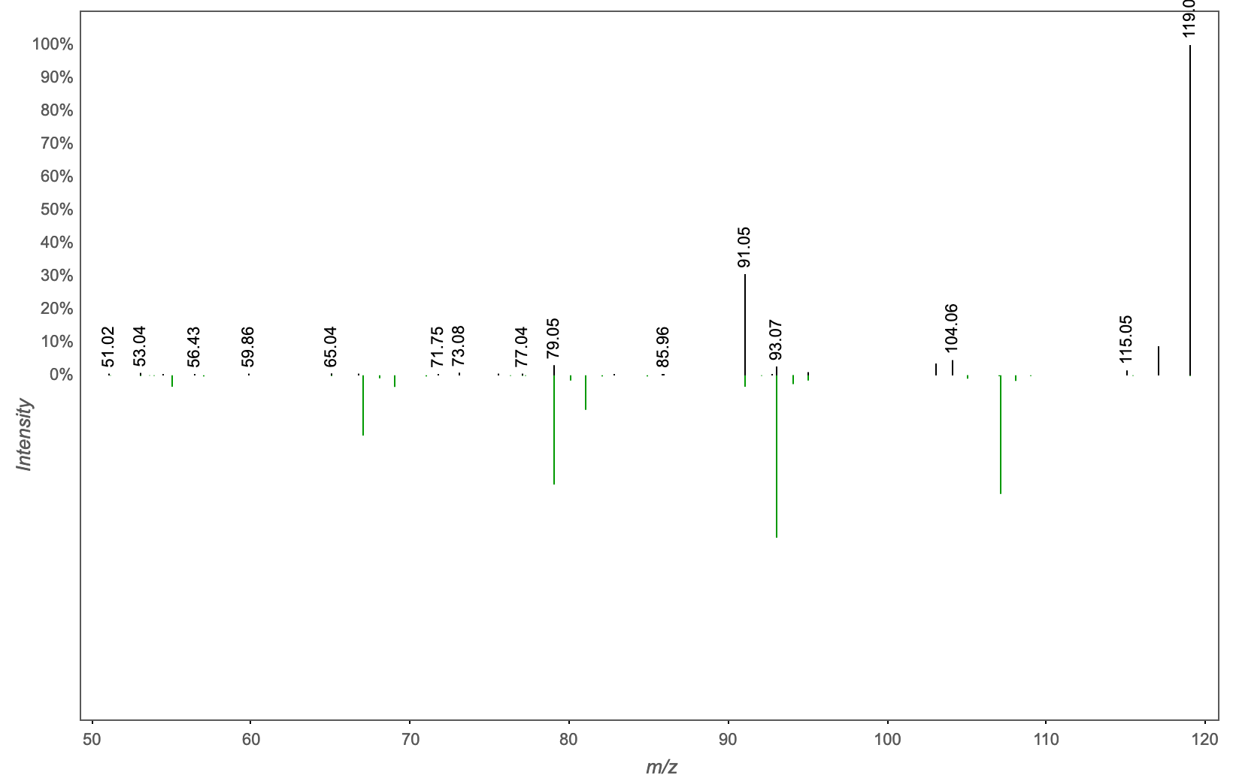
Annotation | M/Z | RT | Cosine Score | Shared Peaks | Cluster Index
Spectral Match to Amantadine from NIST14 | 119.085 | 2.81 | 0.7270 | 4 | 2148

Slide 29
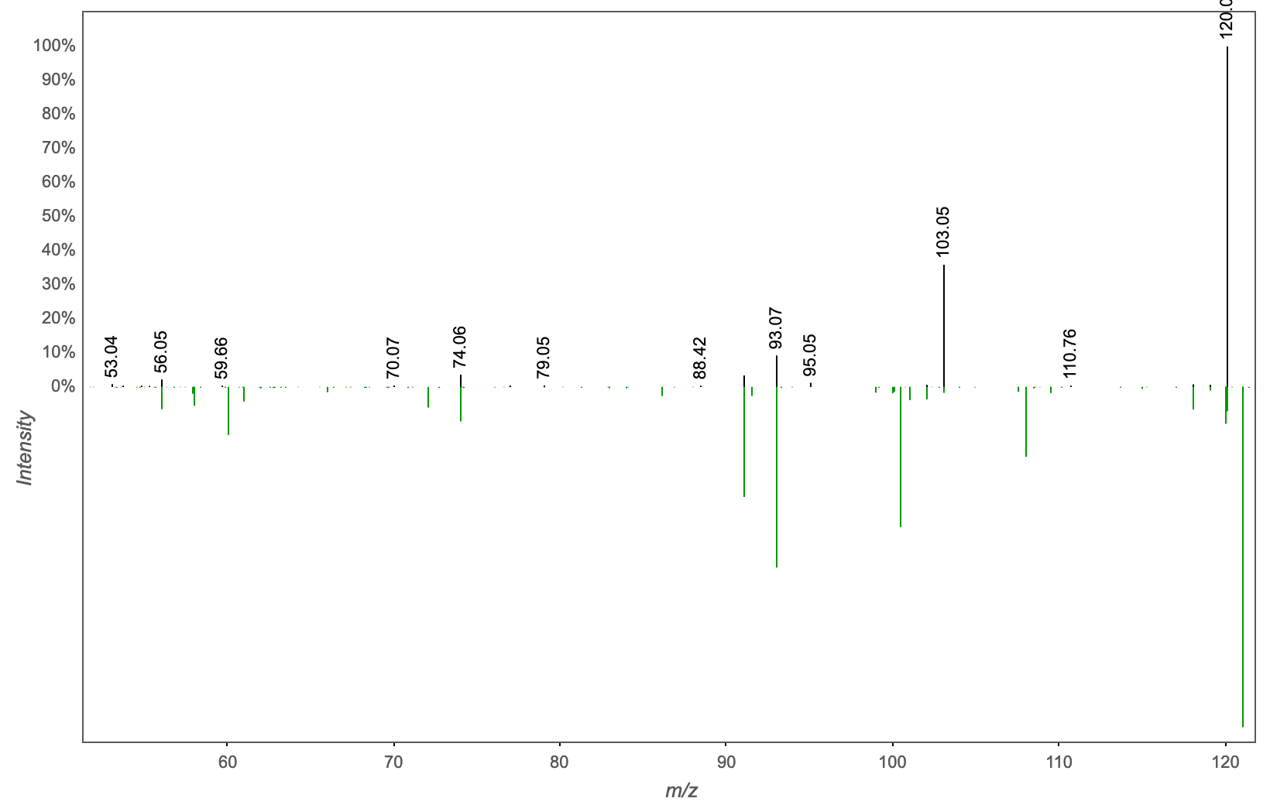
Annotation | M/Z | RT | Cosine Score | Shared Peaks | Cluster Index
Bovinocidin (3-Nitropropionic Acid) | 120.065 | 0.32 | 0.7505 | 4 | 1007

Slide 30
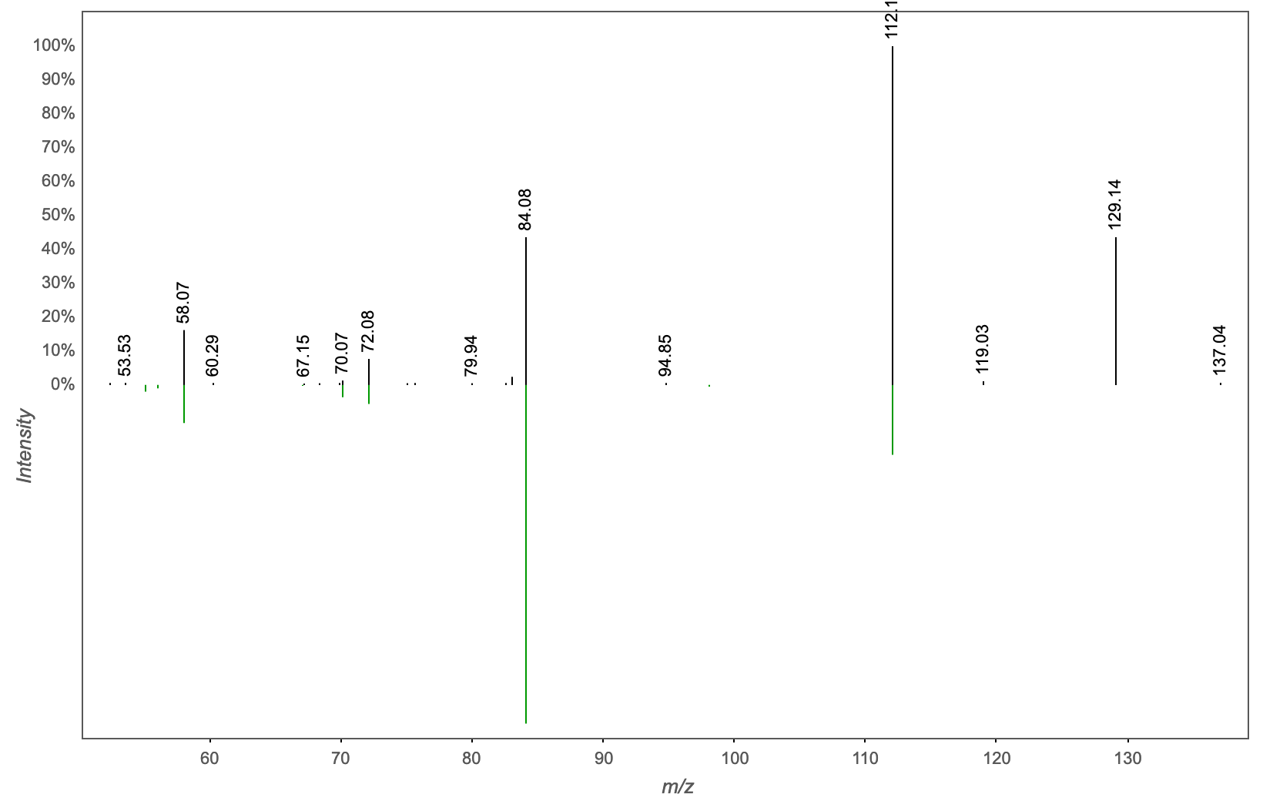
Annotation | M/Z | RT | Cosine Score | Shared Peaks | Cluster Index
Massbank:PB000490 Spermine|N,N'-bis(3-aminopropyl)butane-1,4-diamine | 129.138 | 0.29 | 0.8675 | 4 | 1192

Slide 31
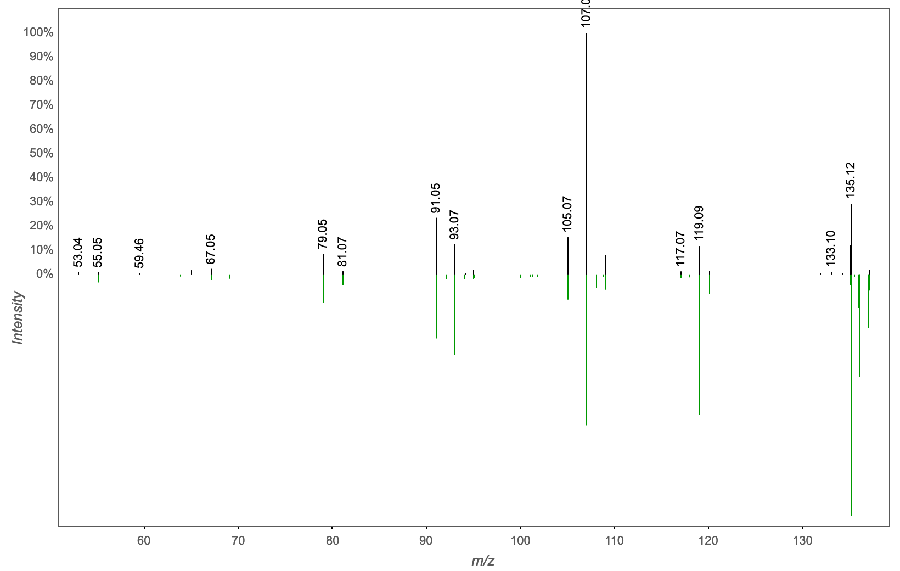
Annotation | M/Z | RT | Cosine Score | Shared Peaks | Cluster Index
Spectral Match to .alpha.-Pinene oxide from NIST14 | 135.08 | 2.81 | 0.9582 | 6 | 2175

Slide 32
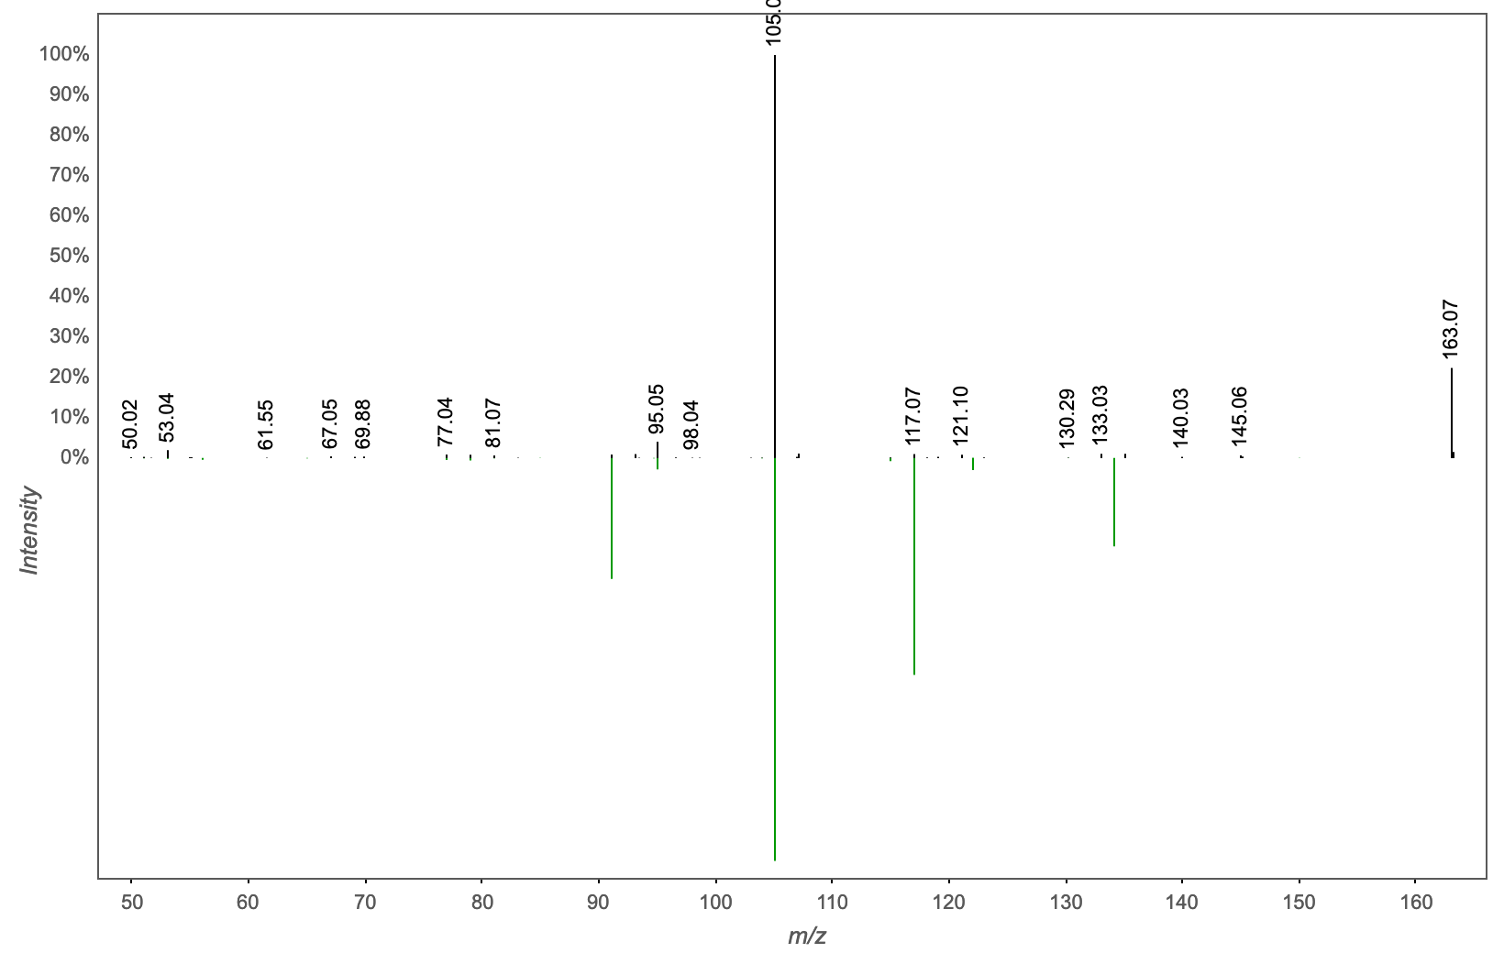
Annotation | M/Z | RT | Cosine Score | Shared Peaks | Cluster Index
NCGC00170025-02!N-(1-hydroxy-3-phenylpropan-2-yl)benzamide [IIN-based: Match] | 163.075 | 2.63 | 0.7051 | 4 | 1366

Slide 33
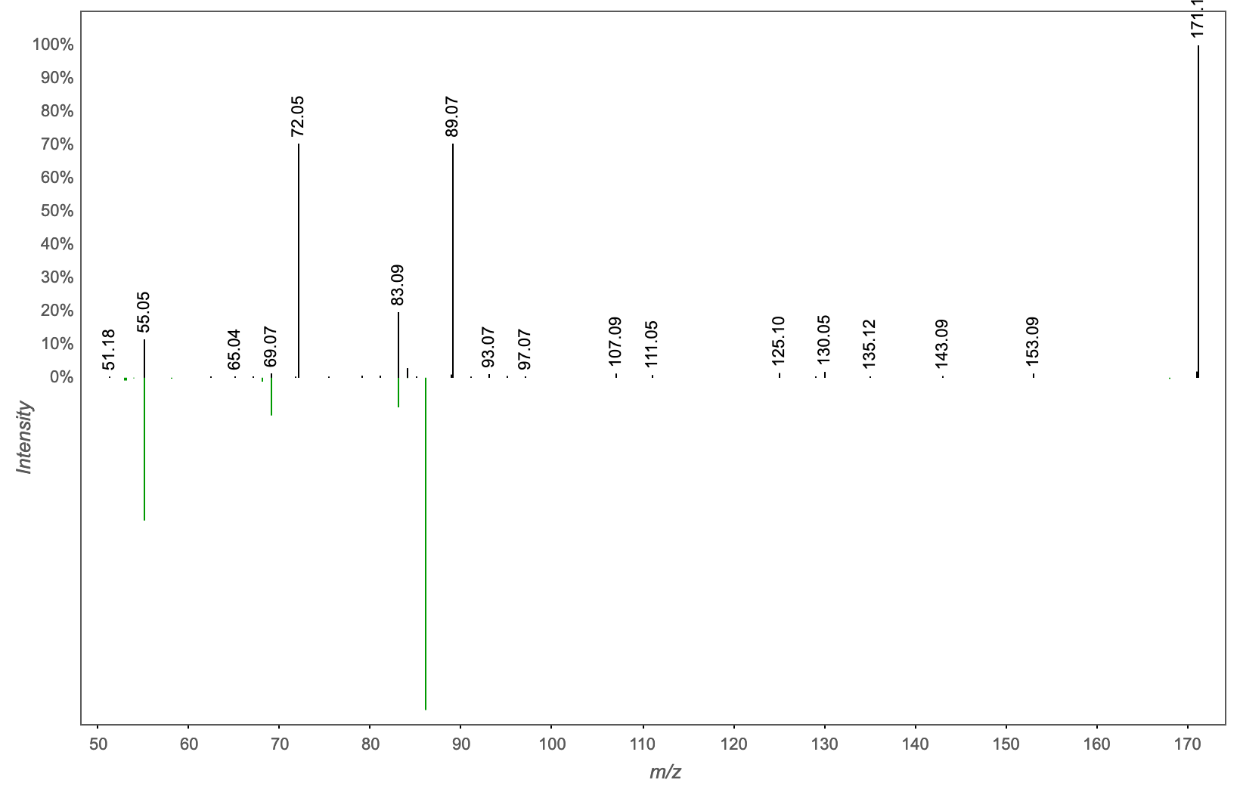
Annotation | M/Z | RT | Cosine Score | Shared Peaks | Cluster Index
Massbank:LU068806 1-Cyclohexylpyrrolidin-2-one|N-Cyclohexyl-2-pyrrolidone | 171.148 | 2.46 | 0.8571 | 4 | 2232

Slide 34
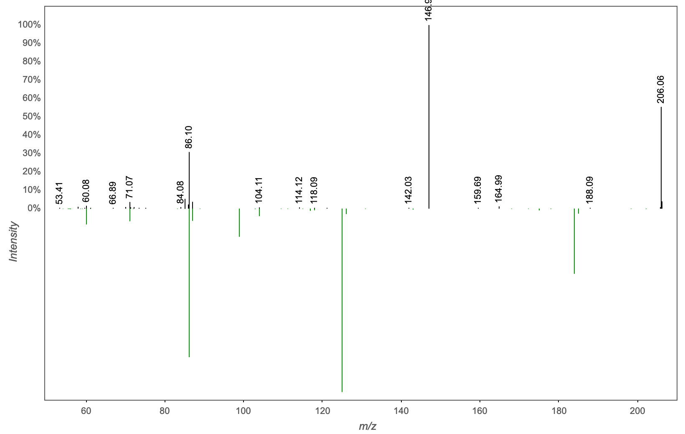
Annotation | M/Z | RT | Cosine Score | Shared Peaks | Cluster Index
PHOSPHOCHOLINE CHLORIDE - 50.00 eV | 206.055 | 0.27 | 0.8721 | 4 | 1156

Slide 35
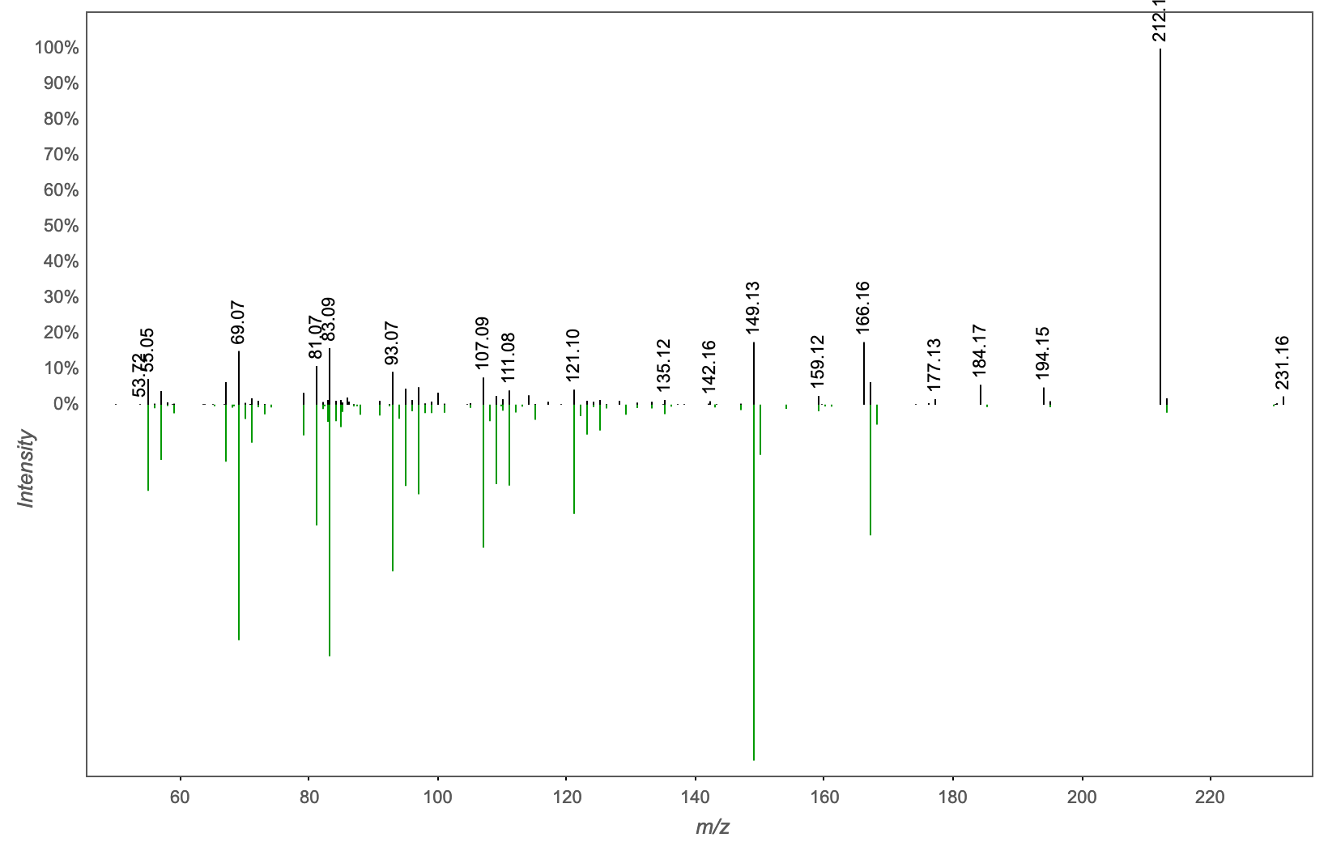
Annotation | M/Z | RT | Cosine Score | Shared Peaks | Cluster Index
Spectral Match to Dodecanedioic acid from NIST14 | 230.174 | 2.51 | 0.8634 | 8 | 1723

Slide 36
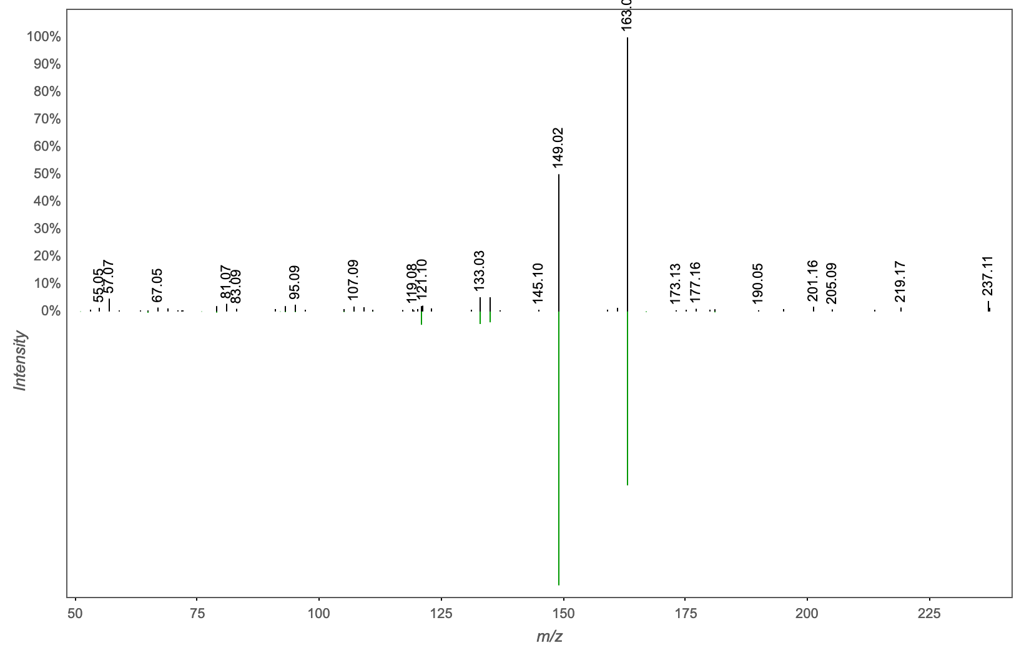
Annotation | M/Z | RT | Cosine Score | Shared Peaks | Cluster Index
Massbank:EQ357803 Aspirin|Acetyl salicilic acid|2-acetyloxybenzoic acid | 237.111 | 2.86 | 0.9038 | 6 | 2238

Slide 37
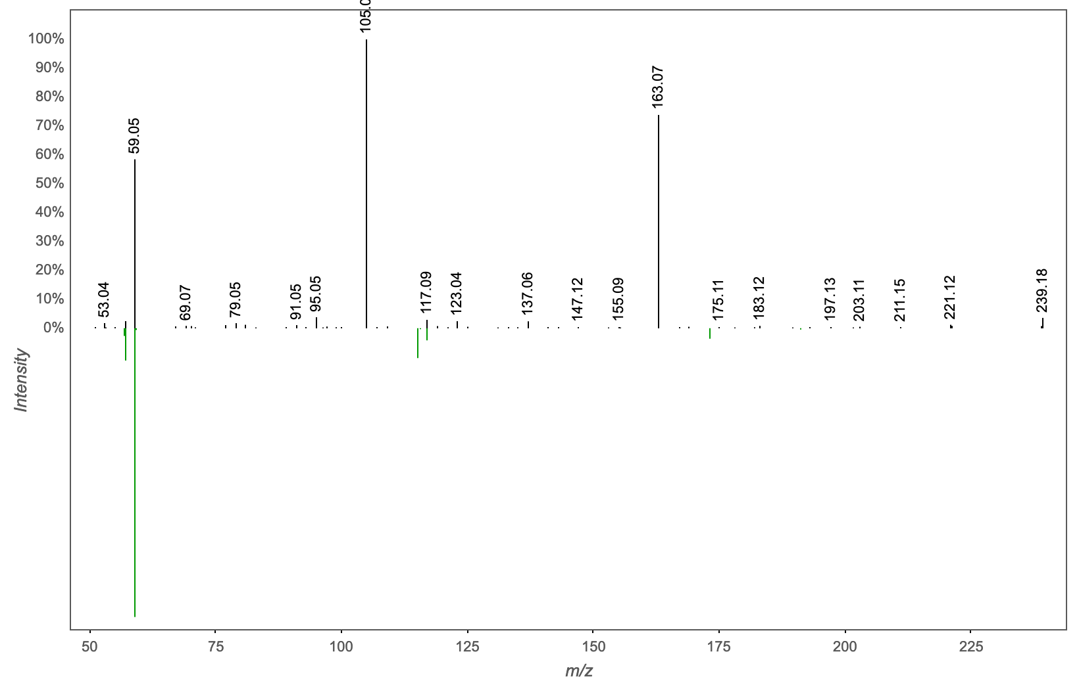
Annotation | M/Z | RT | Cosine Score | Shared Peaks | Cluster Index
Spectral Match to Tri(propylene glycol) butyl ether from NIST14 | 239.127 | 2.63 | 0.7185 | 5 | 1375

Slide 38
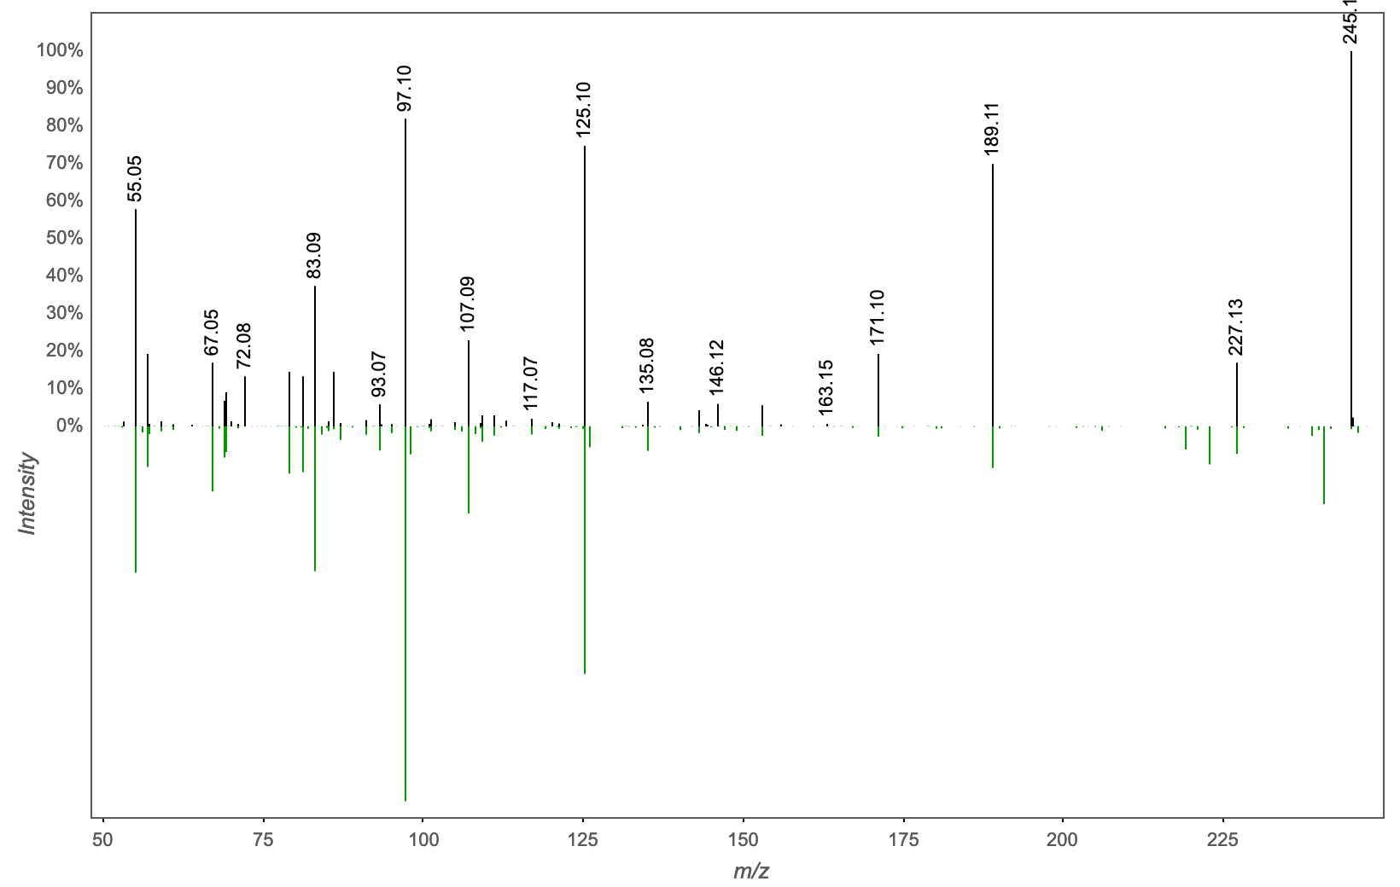
Annotation | M/Z | RT | Cosine Score | Shared Peaks | Cluster Index
9-(2,3-dihydroxypropoxy)-9-oxononanoic acid | 245.138 | 2.34 | 0.8624 | 9 | 1381

Slide 39
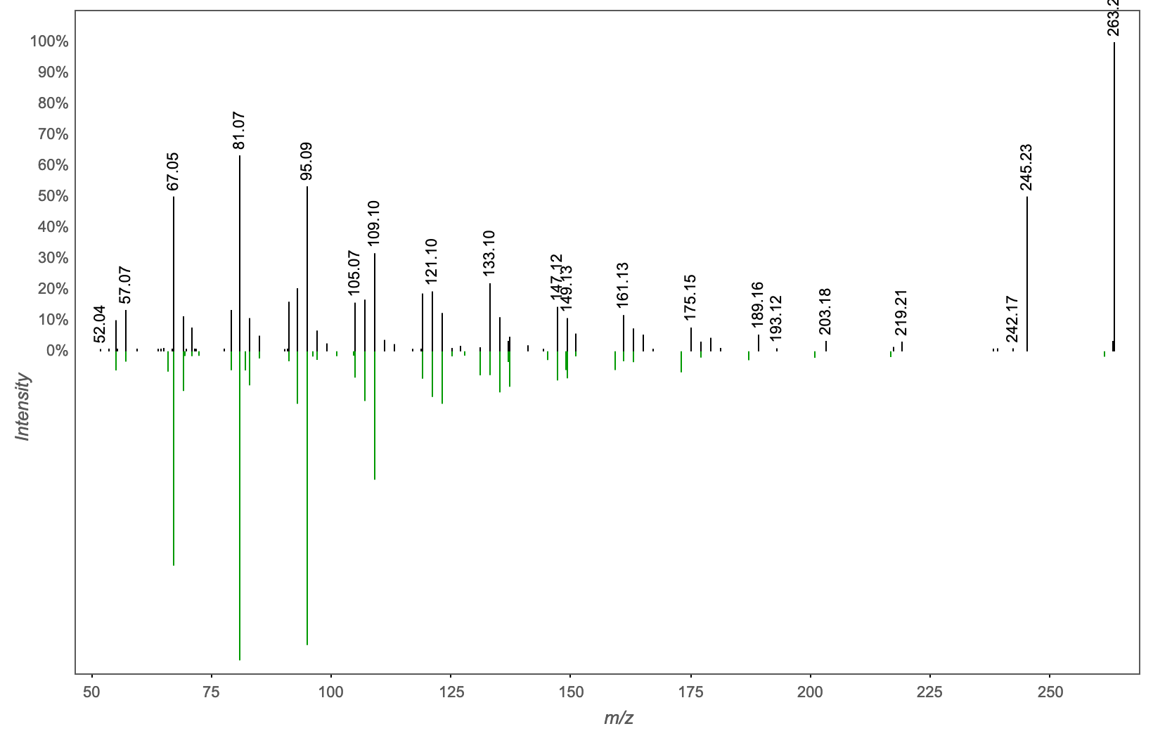
Annotation | M/Z | RT | Cosine Score | Shared Peaks | Cluster Index
Spectral Match to 9Z,11E,13E-Octadecatrienoic acid methyl ester from NIST14 | 263.236 | 3.47 | 0.8230 | 5 | 2203

Slide 40
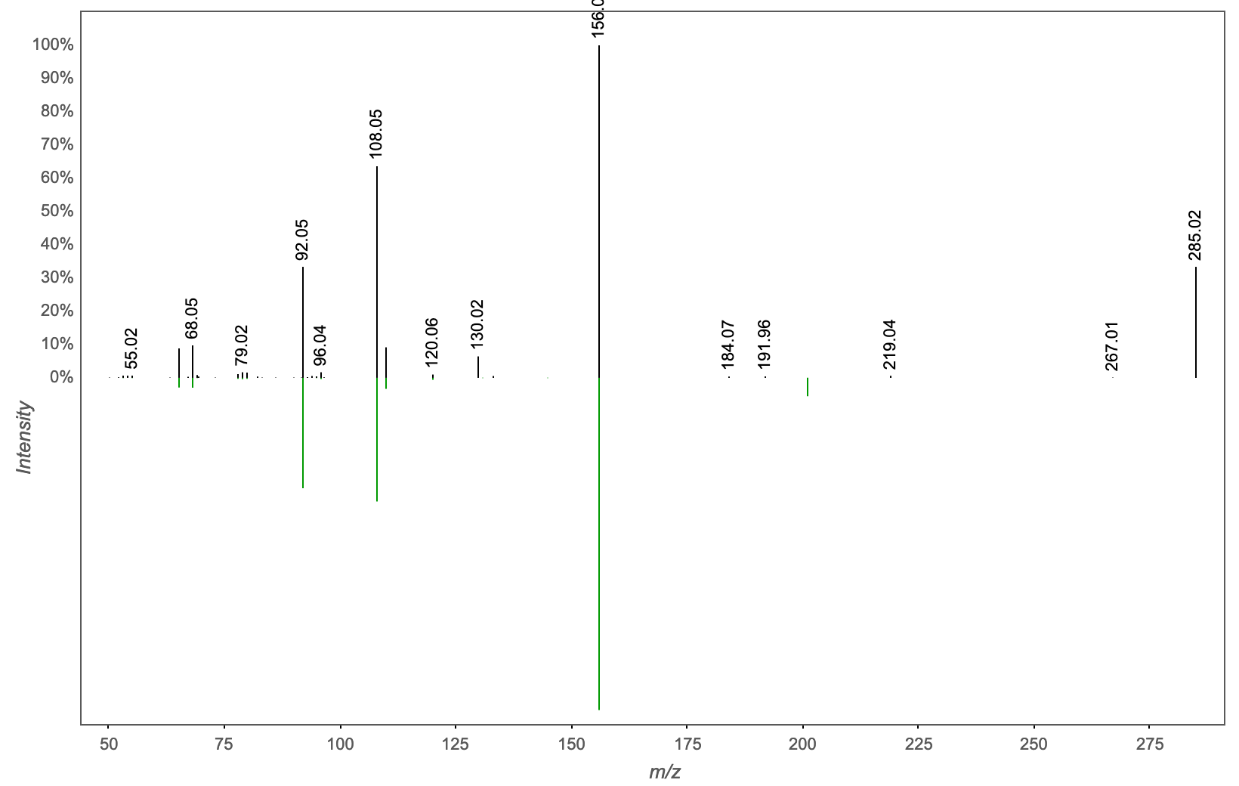
Annotation | M/Z | RT | Cosine Score | Shared Peaks | Cluster Index
MassbankEU:SM878401 4-Amino-N,N-dimethylbenzenesulfonamide | 285.13 | 2.34 | 0.9675 | 6 | 1129

Slide 41
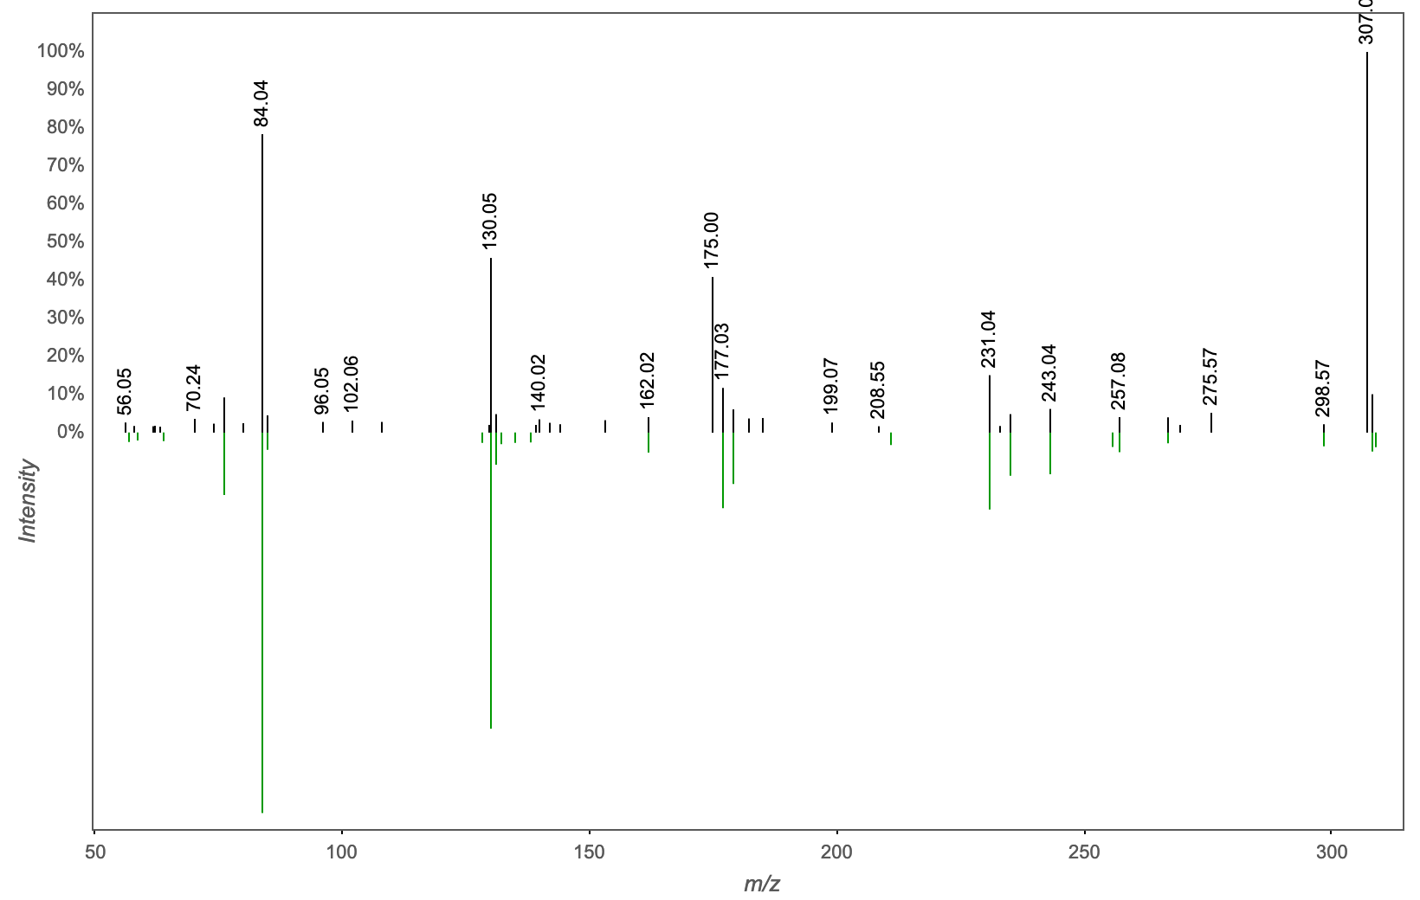
Annotation | M/Z | RT | Cosine Score | Shared Peaks | Cluster Index
Spectral Match to Glutathione, oxidized from NIST14 | 307.043 | 0.28 | 0.8261 | 11 | 964

Slide 42
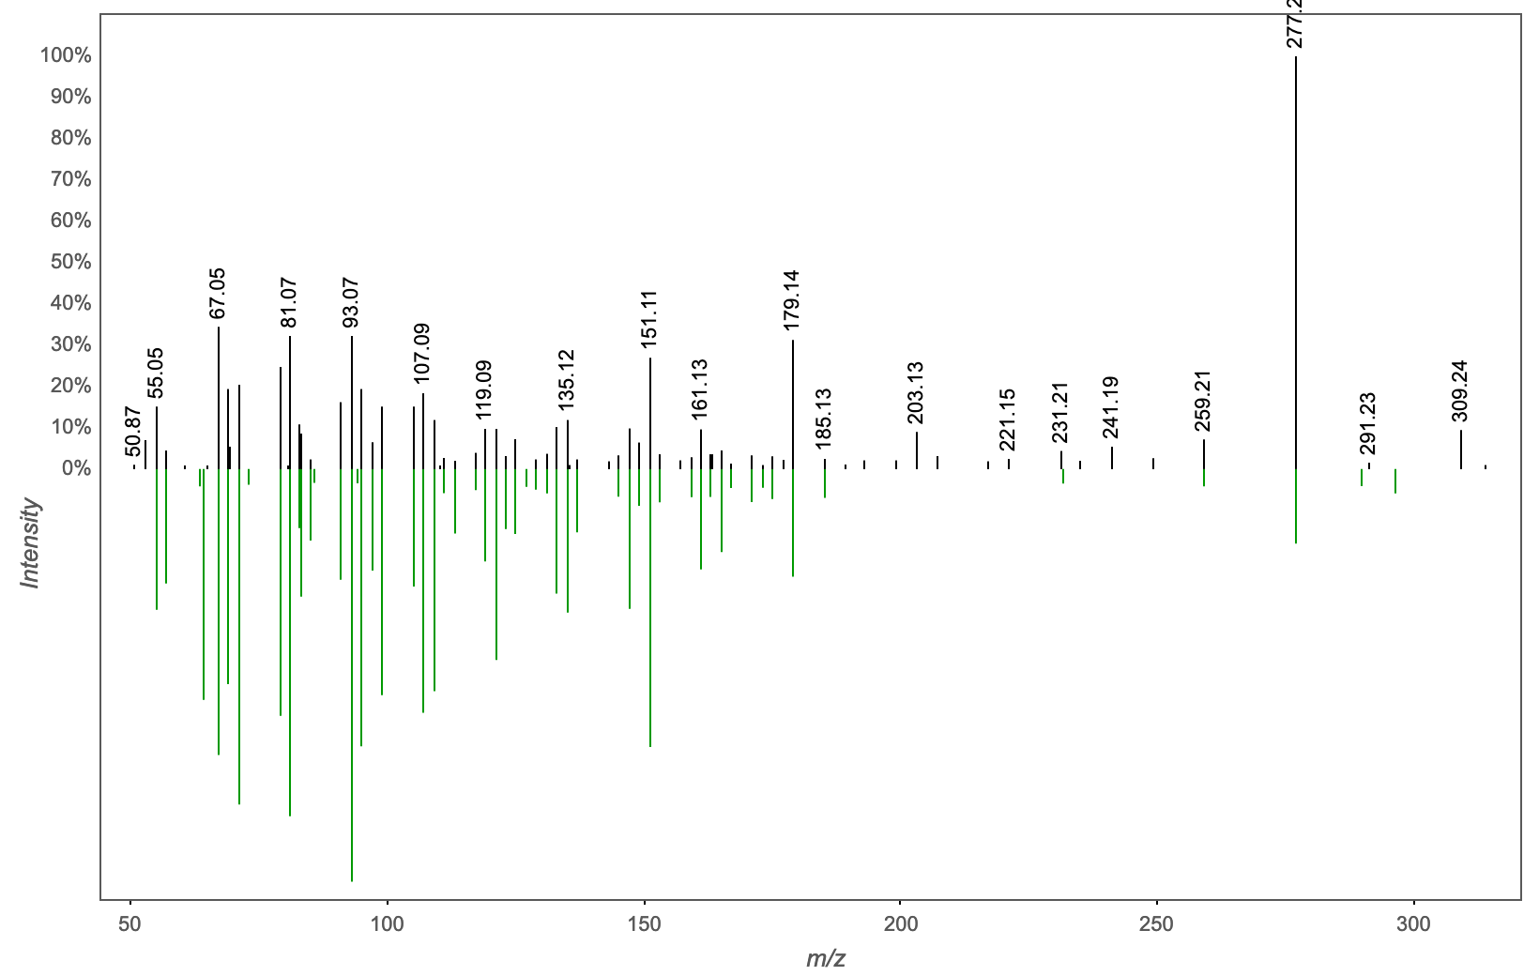
Annotation | M/Z | RT | Cosine Score | Shared Peaks | Cluster Index
Spectral Match to 13-Keto-9Z,11E-octadecadienoic acid from NIST14 | 309.241 | 3.15 | 0.7593 | 9 | 2142

Slide 43
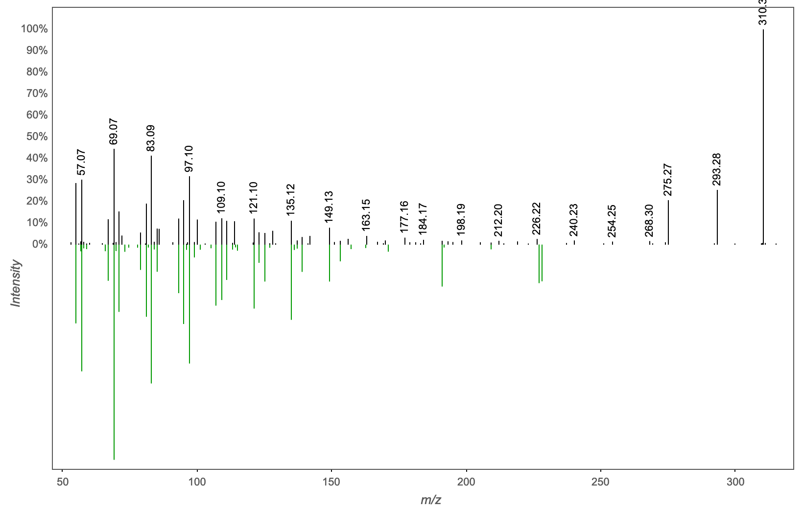
Annotation | M/Z | RT | Cosine Score | Shared Peaks | Cluster Index
Spectral Match to Myristoleic acid from NIST14 | 310.309 | 3.34 | 0.8531 | 8 | 1172

Slide 44
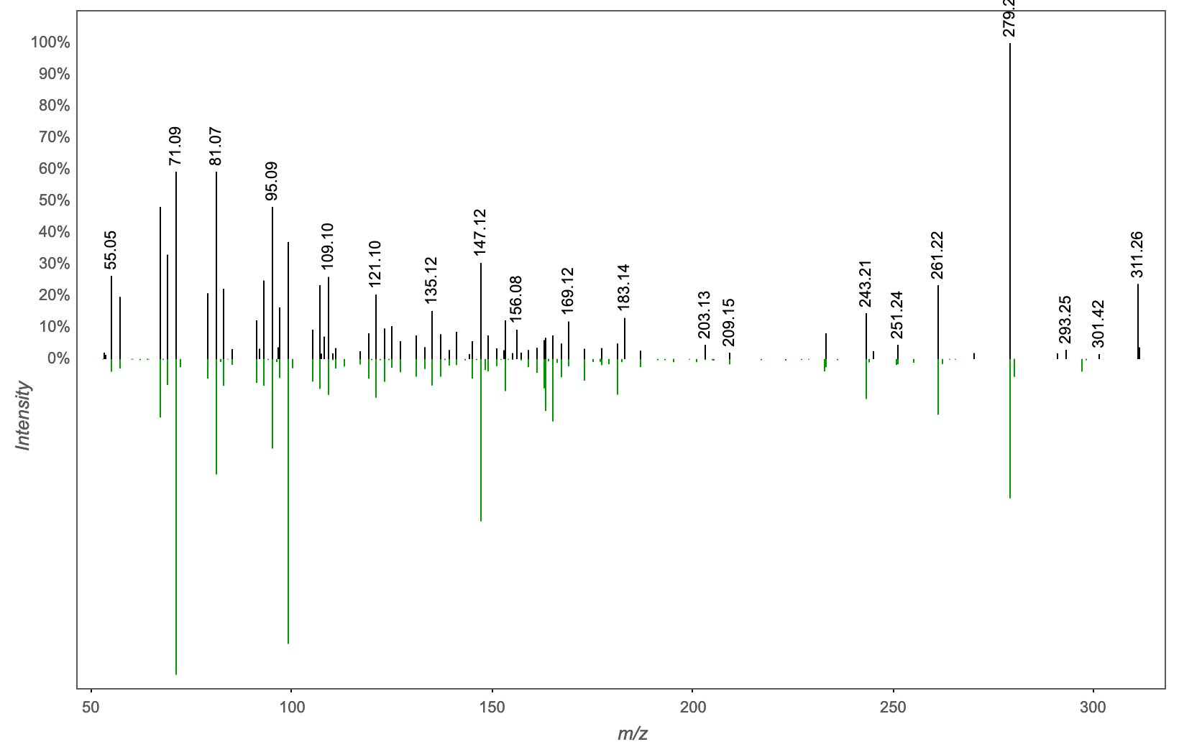
Annotation | M/Z | RT | Cosine Score | Shared Peaks | Cluster Index
Spectral Match to 12(13)-Epoxy-9Z-octadecenoic acid from NIST14 | 311.256 | 3.22 | 0.8039 | 10 | 2126

Slide 45

Annotation | M/Z | RT | Cosine Score | Shared Peaks | Cluster Index
Spectral Match to 13-Keto-9Z,11E-octadecadienoic acid from NIST14 | 313.236 | 2.67 | 0.7014 | 8 | 2343

Slide 46
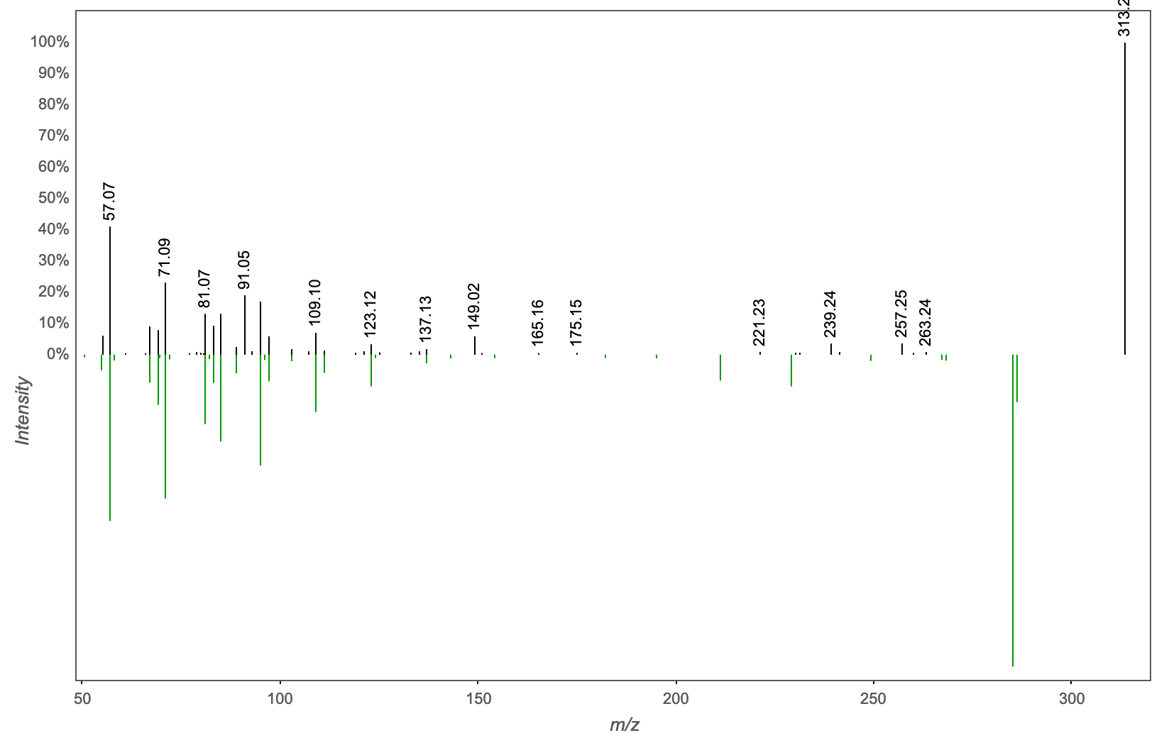
Annotation | M/Z | RT | Cosine Score | Shared Peaks | Cluster Index
Spectral Match to Glycerol 1-myristate from NIST14 | 313.272 | 3.16 | 0.8287 | 9 | 2149

Slide 47
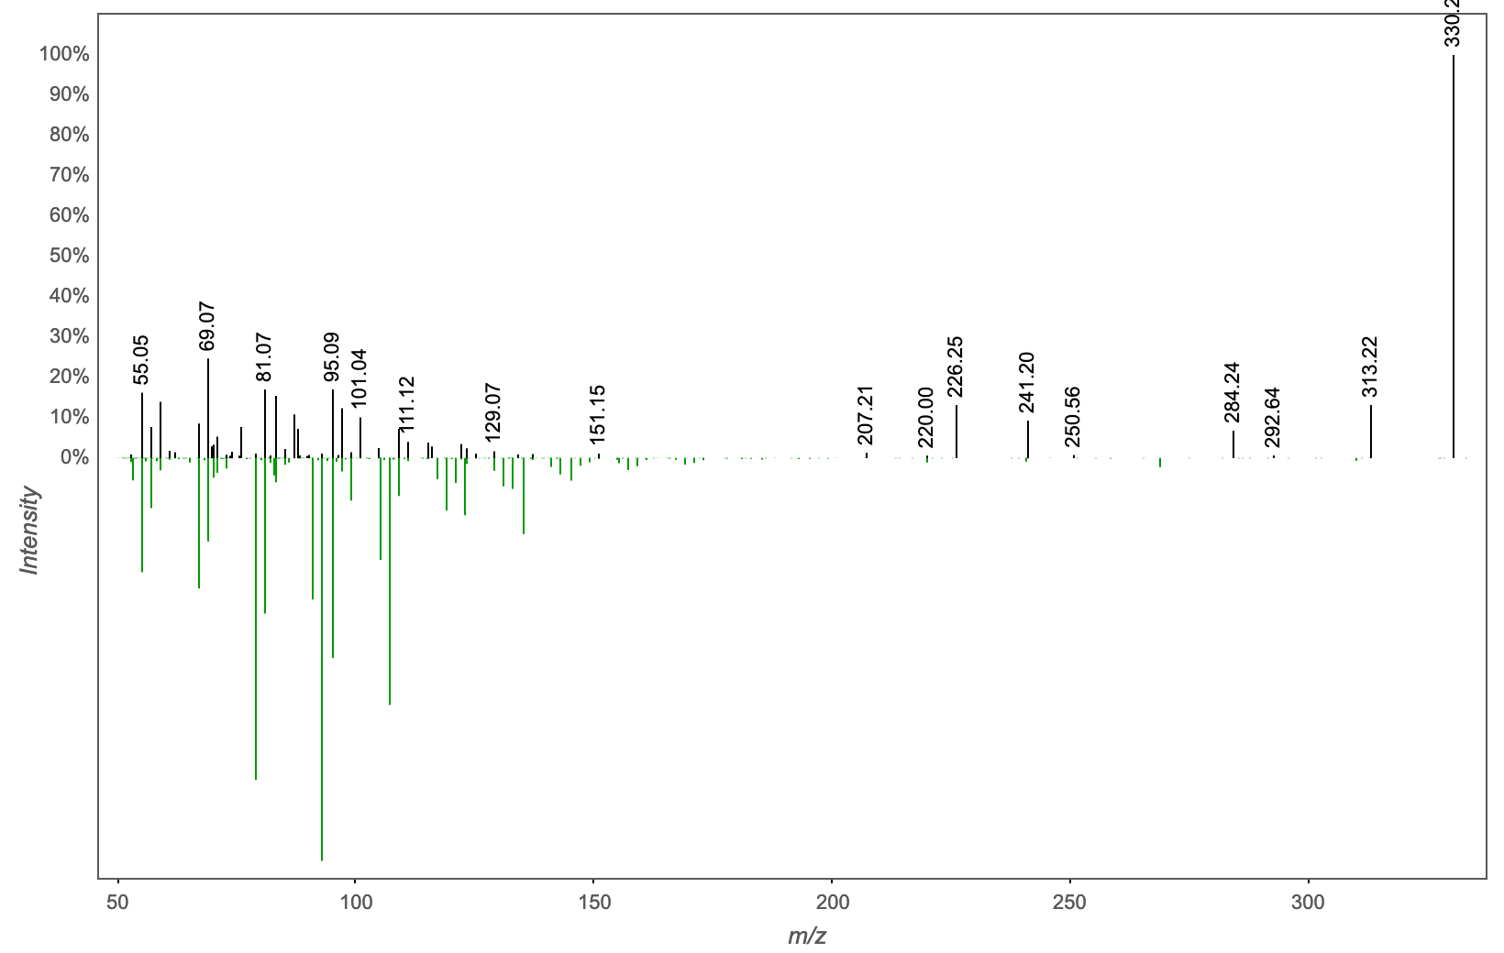
Annotation | M/Z | RT | Cosine Score | Shared Peaks | Cluster Index
14-hydroxy-14-(hydroxymethyl)-5,9-dimethyltetracyclo[11.2.1.0,?.0?,?]hexadecane-5-carboxylic acid | 330.244 | 3.06 | 0.7260 | 7 | 2129

Slide 48
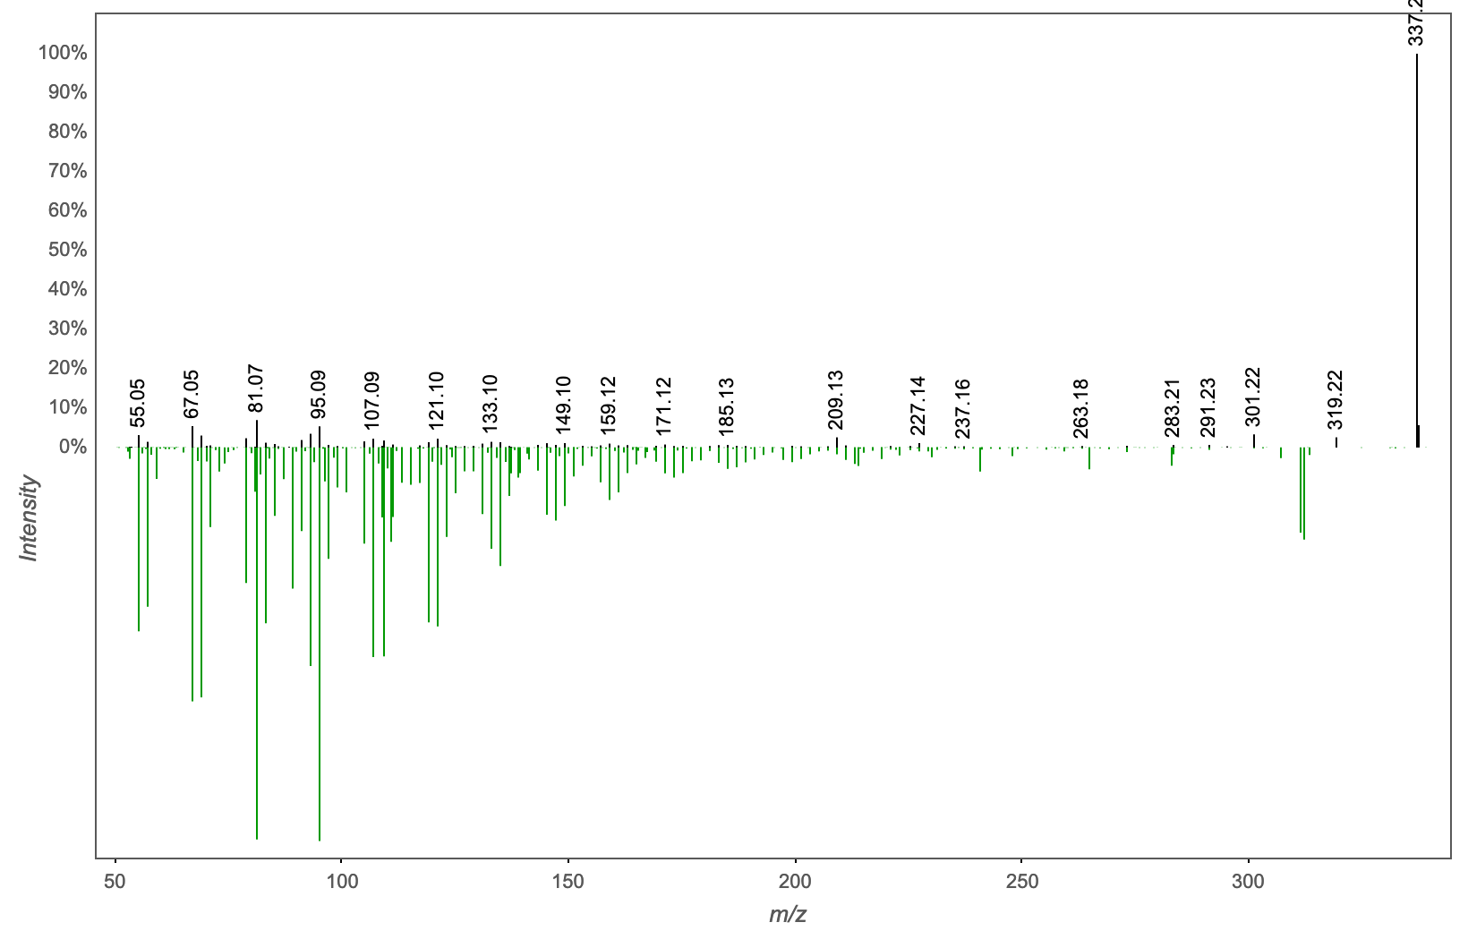
Annotation | M/Z | RT | Cosine Score | Shared Peaks | Cluster Index
gamma-sitosterol | 337.234 | 2.8 | 0.7949 | 8 | 2264

Slide 49
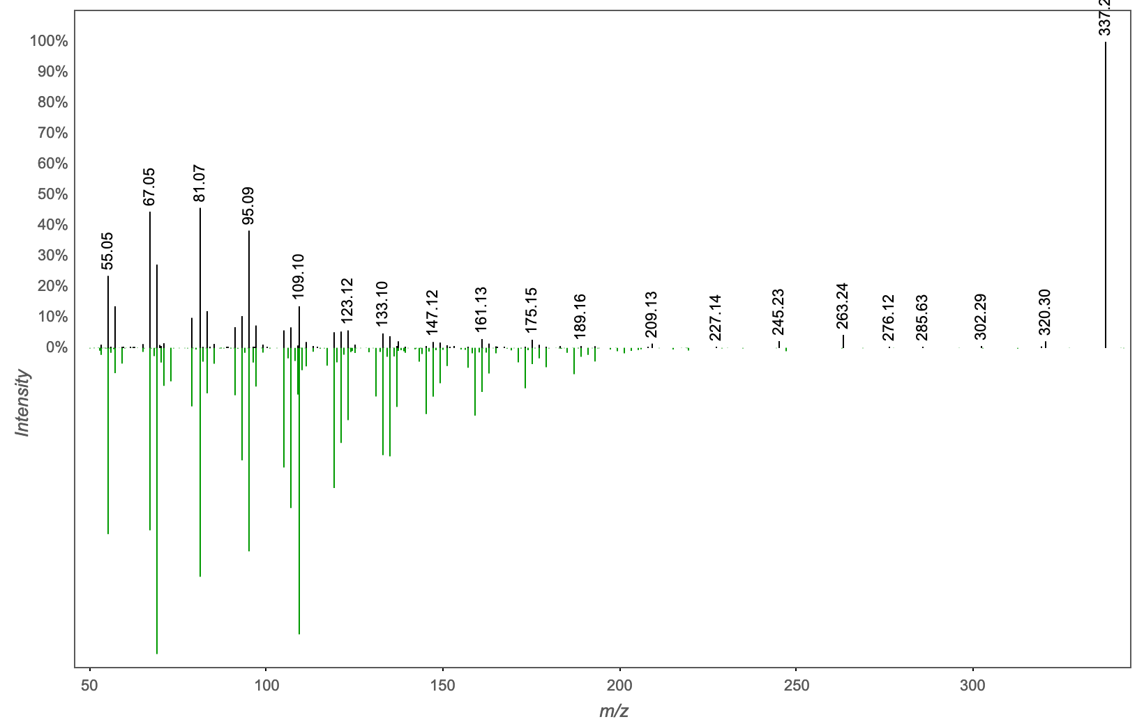
Annotation | M/Z | RT | Cosine Score | Shared Peaks | Cluster Index
5-[(8aS)-2,5,5,8a-tetramethyl-3-oxo-4a,6,7,8-tetrahydro-4H-naphthalen-1-yl]-3-methylpentanoic acid | 337.272 | 3.15 | 0.8364 | 8 | 2091

Slide 50
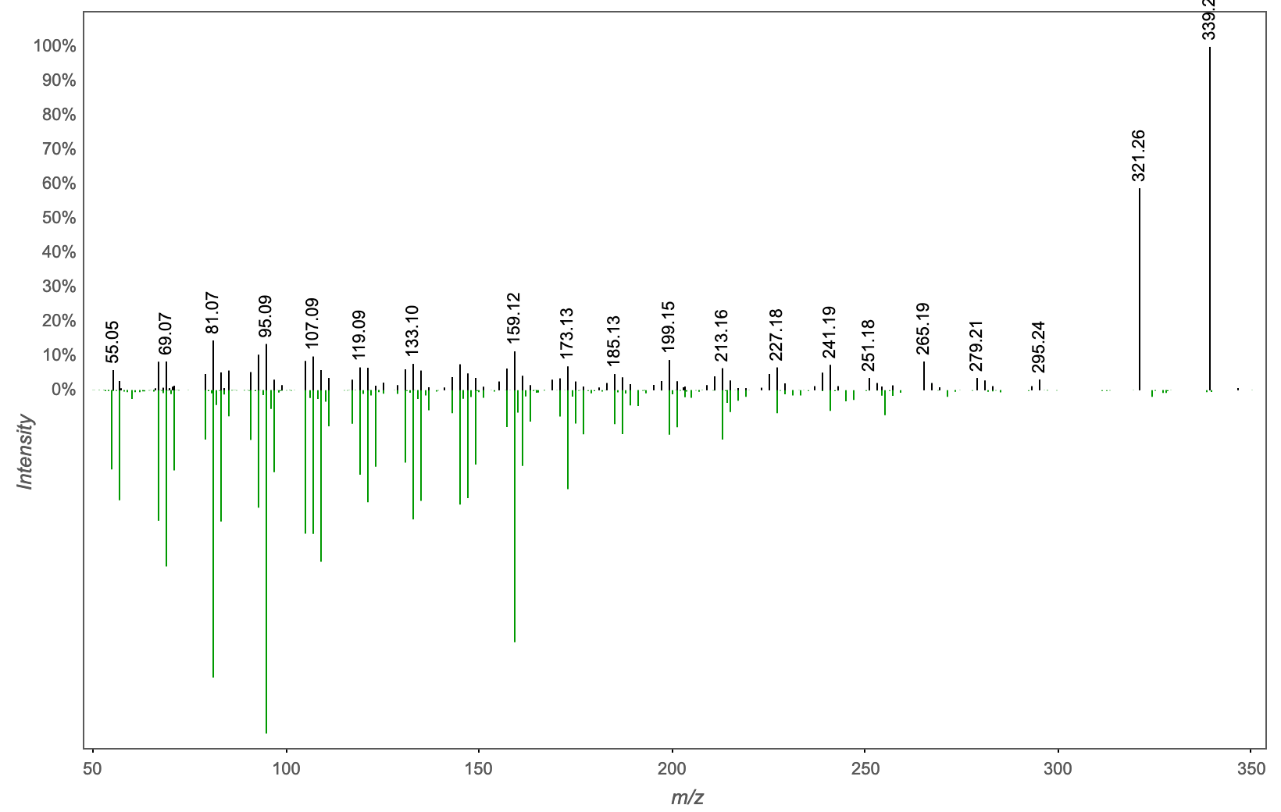
Annotation | M/Z | RT | Cosine Score | Shared Peaks | Cluster Index
3Beta-Hydroxy-23,24-Bisnorchol-5-Enic Acid | 339.267 | 2.82 | 0.7473 | 11 | 2119

Slide 51
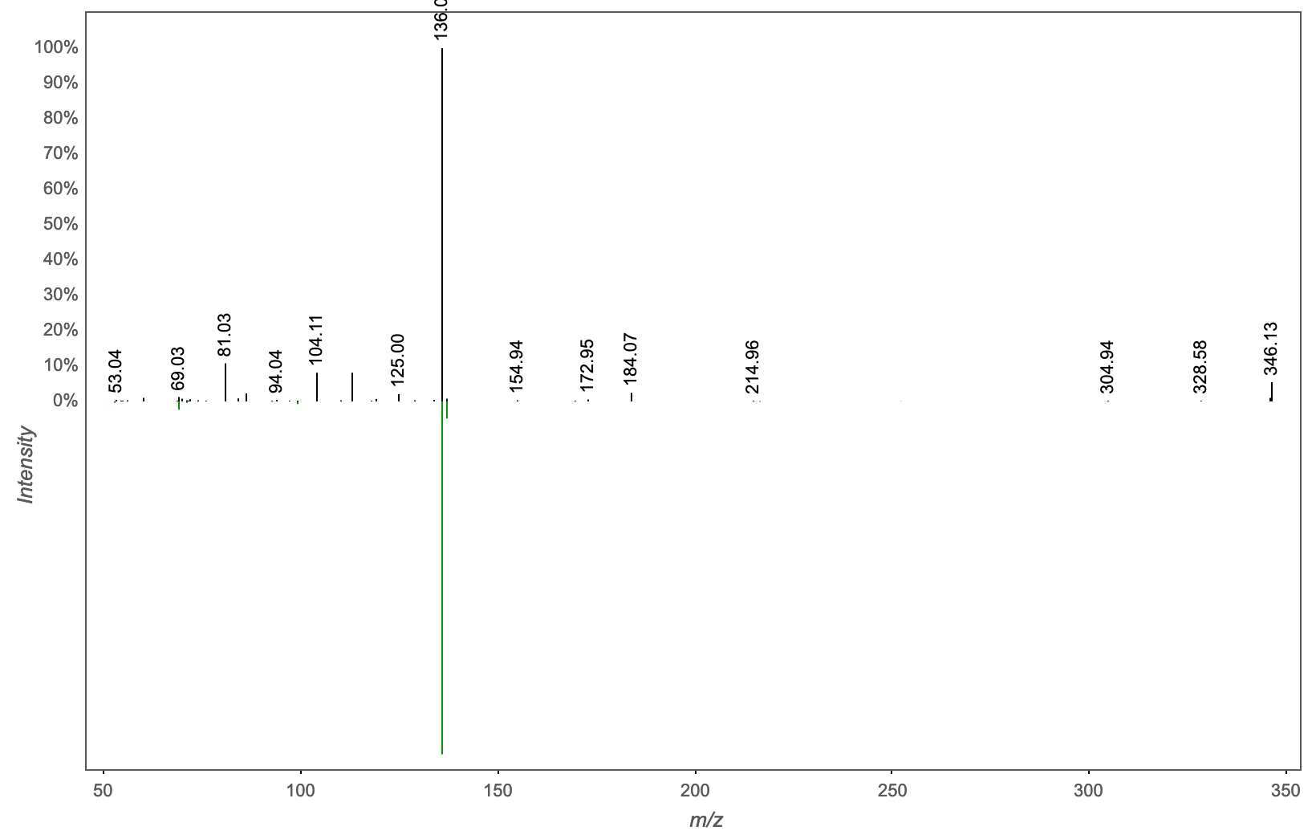
Annotation | M/Z | RT | Cosine Score | Shared Peaks | Cluster Index
cordycepin | 346.09 | 0.42 | 0.8456 | 4 | 1790

Slide 52
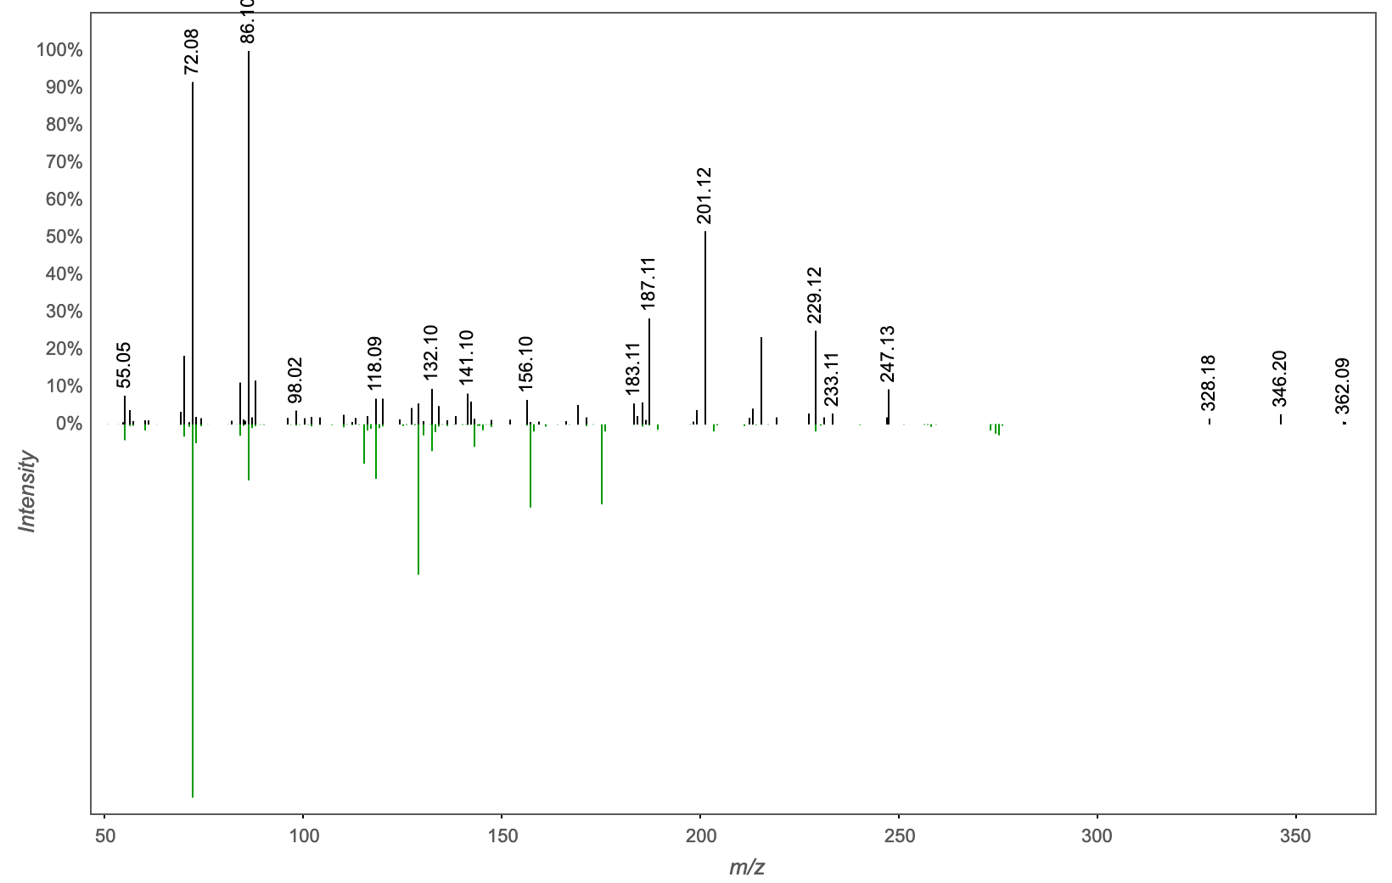
Annotation | M/Z | RT | Cosine Score | Shared Peaks | Cluster Index
Spectral Match to Val-Gly-Val from NIST14 | 346.198 | 2.19 | 0.7734 | 7 | 2314

Slide 53
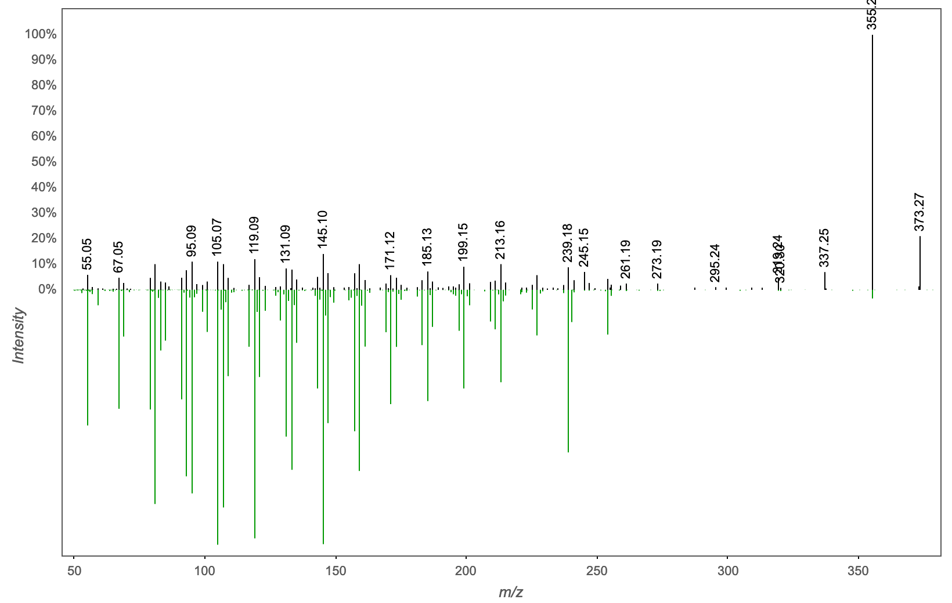
Annotation | M/Z | RT | Cosine Score | Shared Peaks | Cluster Index
CHOLIC ACID | 373.272 | 2.67 | 0.8503 | 16 | 2080

Slide 54
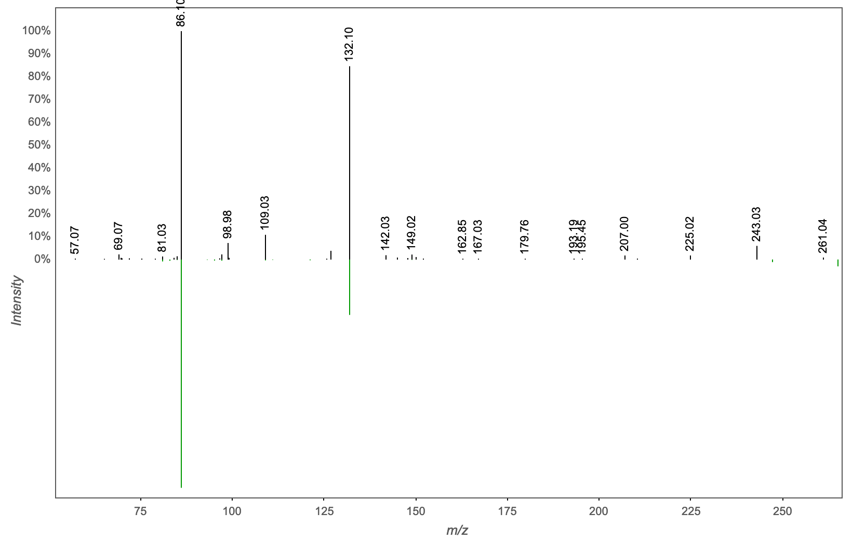
Annotation | M/Z | RT | Cosine Score | Shared Peaks | Cluster Index
Massbank:RP029702 N-Oleyl-Leucine|N-oleoyl leucine|(2S)-4-methyl-2-[[(Z)-octadec-9-enoyl]amino]pentanoic acid | 392.13 | 0.43 | 0.8398 | 4 | 1438

Slide 55

Annotation | M/Z | RT | Cosine Score | Shared Peaks | Cluster Index
MassbankEU:SM880602 Tri(butoxyethyl)phosphate|Tris(2-butoxyethyl) phosphate | 399.306 | 3.14 | 0.8122 | 8 | 1492

Slide 56

Annotation | M/Z | RT | Cosine Score | Shared Peaks | Cluster Index
Spectral Match to Lyso-PAF C-18 from NIST14 | 424.281 | 2.66 | 0.9532 | 7 | 1990

Slide 57

Annotation | M/Z | RT | Cosine Score | Shared Peaks | Cluster Index
Contaminant vial septum ThermoFisher C5000-44B | 554.174 | 3.42 | 0.9376 | 20 | 1772

Slide 58

Annotation | M/Z | RT | Cosine Score | Shared Peaks | Cluster Index
Cer(d18:1/24:1); [M+H]+ C42H82N1O3 | 594.58 | 4.61 | 0.8333 | 8 | 2927

Slide 59

Annotation | M/Z | RT | Cosine Score | Shared Peaks | Cluster Index
GalCer(d18:1/18:0); [M+H]+ C42H82N1O8 | 650.642 | 3.47 | 0.8132 | 5 | 2352

Slide 60

Annotation | M/Z | RT | Cosine Score | Shared Peaks | Cluster Index
Spectral Match to N-Oleoyl-D-erythro-sphingosylphosphorylcholine from NIST14 | 672.419 | 3.07 | 0.8067 | 6 | 1236

Slide 61

Annotation | M/Z | RT | Cosine Score | Shared Peaks | Cluster Index
Spectral Match to N-Oleoyl-D-erythro-sphingosylphosphorylcholine from NIST14 | 672.419 | 3.22 | 0.7623 | 5 | 1643

Slide 62

Annotation | M/Z | RT | Cosine Score | Shared Peaks | Cluster Index
Spectral Match to 1-Hexadecanoyl-2-(9Z-octadecenoyl)-sn-glycero-3-phosphocholine from NIST14 | 700.45 | 3.2 | 0.7696 | 10 | 1629

Slide 63

Annotation | M/Z | RT | Cosine Score | Shared Peaks | Cluster Index
Spectral Match to 1-(9Z-Octadecenoyl)-2-tetradecanoyl-sn-glycero-3-phosphocholine from NIST14 | 706.499 | 3.26 | 0.9640 | 9 | 1895

Slide 64

Annotation | M/Z | RT | Cosine Score | Shared Peaks | Cluster Index
Spectral Match to 1-Octadecanoyl-2-(5Z,8Z,11Z,14Z-eicosatetraenoyl)-sn-glycero-3-phosphocholine from NIST14 | 768.586 | 4.31 | 0.8932 | 7 | 1074

Slide 65

Annotation | M/Z | RT | Cosine Score | Shared Peaks | Cluster Index
Spectral Match to Isodeoxycholic acid from NIST14 | 829.481 | 2.8 | 0.7605 | 4 | 2144

